Slide 1

Calculation Policy
June 2023
This policy has been largely adapted from the NCETM and White Rose Maths Hub calculation policies with further material added.
It is a working document and will be revised and amended as necessary.
Text in grey shows objectives from the June 2020 Ready to Progress document.

Slide 2
Progression in Teaching and Learning
Addition

Slide 3



Progression in Teaching and Learning Addition: EYFS
Guidance / Models / Images | Key Vocabulary
If available, Numicon shapes are introduced straight away and can be used to: identify 1 more/less combine pieces to add find number bonds add without counting. Children can record this by printing or drawing around the Numicon pieces or using 5-frames or 10-frames. Children begin to combine groups of objects using concrete apparatus. Construct number sentences verbally or using cards to go with practical activities. Children are encouraged to read number sentences aloud in different ways. “Three add two equals five.” “Five is equal to three and two.” Children make a record in pictures, words or symbols of addition activities already carried out. Solve simple problems using fingers. Number tracks can be introduced to count up, on and to find one more. What is 1 more than 4? What is 1 more than 13? Number lines can then be used alongside number tracks and practical apparatus to solve addition calculations and word problems. Children will need opportunities to look at and talk about different models and images as they move between representations. | Games and songs can be a useful way to begin using vocabulary involved in addition, e.g. ‘Alice the Camel’. Add More And Make Sum Total Altogether Score Double One more, two more, ten more… How many more to make…? How many more is … than …?

Slide 4
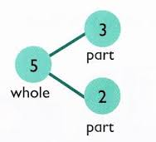

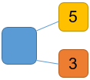
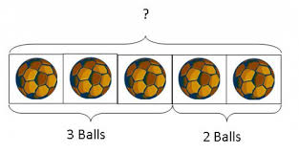
Progression in Teaching and Learning Addition: YEAR 1
Year 1 Objectives | Read, write and interpret equations containing addition (+), subtraction (-) and equals (=) symbols, and relate additive expressions and equations to real-life contexts. Read, write and interpret mathematical statements involving addition (+), subtraction (–) and equals (=) signs. Compose numbers to 10 from 2 parts, and partition numbers into parts, including recognising odd and even numbers. Represent and use number bonds and related subtraction facts within 20. Add and subtract one-digit and two-digit numbers to 20, including zero.
Strategy | Enactive | Iconic | Symbolic
Combining 2 parts to make a whole: part-part-whole model |  |  | 4 + 3 = 7 10 = 6 + 4
Starting at the bigger number and counting on | Start with the larger number on the bead string and then count on to the smaller number 1 by 1 to find the answer. | 12 + 5 = 17 Start at the larger number on the number line and count on in ones or in one jump to find the answer. | 12 + 5 = 17 Place the larger number in your head and count on the smaller number to find your answer.
Use pictures to add 2 numbers together as a group or in a bar.
Use cubes to add 2 numbers together as a group or in a bar.
Use the
part-whole diagram to move into the abstract.
8 | 1
+ 5

Slide 5
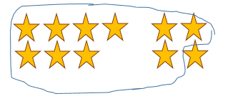
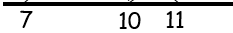
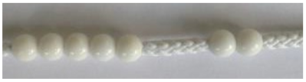


Progression in Teaching and Learning Addition: YEAR 1
Year 1 Objectives | Read, write and interpret equations containing addition (+), subtraction (-) and equals (=) symbols, and relate additive expressions and equations to real-life contexts. Read, write and interpret mathematical statements involving addition (+), subtraction (–) and equals (=) signs. Compose numbers to 10 from 2 parts, and partition numbers into parts, including recognising odd and even numbers. Represent and use number bonds and related subtraction facts within 20. Add and subtract one-digit and two-digit numbers to 20, including zero.
Strategy | Enactive | Iconic | Symbolic
Regrouping to make 10 This is an essential skill for column addition later. | 6 + 5 = 11 |  | 7 + 4 = 11 If I am at 7, how many more do I need to make 10. How many more do I add on now?
Represent and use number bonds and subtraction facts within 20 | 2 more than 5 |  | Emphasis should be on the language: ‘1 more than 5 is equal to 6’ ‘2 more than 5 is 7’ ‘8 is 3 more than 5’.
7 + 4 = 11
Regroup or partition the smaller number to make 10.
Start with the bigger number & use the smaller number to make 10.
7 + 4 = 11
3
1
+ 3
+ 1
+ 5
+ 2
 | Draw 2 more hats
5 + 2 =

Slide 6


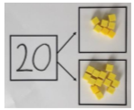
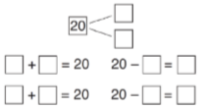

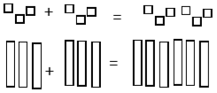
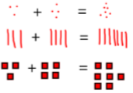
Progression in Teaching and Learning Addition: YEAR 2
Year 2 Objectives | Add and subtract across 10. Recall and use addition facts to 20 fluently, and derive and use related facts up to 100. Recognise the subtraction structure of ‘difference’ and answer questions of the form ‘How many more…?’ Add and subtract numbers using concrete objects, pictorial representation, and mentally, including: a 2-digit number and ones, a 2-digit number and tens, two 2-digit numbers, three 1-digit numbers. Add and subtract within 100 by applying related 1-digit addition and subtraction facts; add and subtract only ones or only tens to/from a 2-digit number. Add and subtract within 100 by applying related 1-digit addition and subtraction facts; add and subtract any two 2-digit numbers.
Strategy | Enactive | Iconic | Symbolic
Adding multiples of ten | 50 = 30 + 20 Model using Dienes and bead strings. | 3 tens + 5 tens = ____ tens 30 + 50 = ____ Use representations for base ten. | 20 + 30 = 50 70 = 50 + 20 40 + = 60
Using known number facts Part-whole
Using known facts |  |  | 3 + 4 = 7 Leads to 30 + 40 = 70 Leads to 300 + 400 = 700
Children explore ways of making numbers within 20.
E.g. Using known facts: If I know that 10 = 3 + 7
then I know 20 = 13 + 7
Children draw representations of 100s, 10s and 1s.

Slide 7


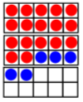
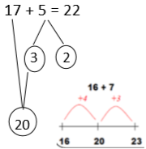

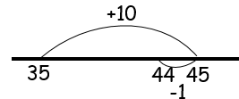
Progression in Teaching and Learning Addition: YEAR 2
Year 2 Objectives | Add and subtract across 10. Recall and use addition facts to 20 fluently, and derive and use related facts up to 100. Recognise the subtraction structure of ‘difference’ and answer questions of the form ‘How many more…?’ Add and subtract numbers using concrete objects, pictorial representation, and mentally, including: a 2-digit number and ones, a 2-digit number and tens, two 2-digit numbers, three 1-digit numbers. Add and subtract within 100 by applying related 1-digit addition and subtraction facts; add and subtract only ones or only tens to/from a 2-digit number. Add and subtract within 100 by applying related 1-digit addition and subtraction facts; add and subtract any two 2-digit numbers.
Strategy | Enactive | Iconic | Symbolic
Using a bar model to represent addition | 3 + 4 = 7 | 7 + 3 = 10 23 + 25 = 48 | 23 + 25 = 48
Add a 2-digit number and ones |  |  | 17 + 5 = 22 Explore related facts: 17 + 5 = 22 5 + 17 = 22 22 – 17 = 5 22 – 5 = 17
Add 9 or 11 by adding 10 and adjusting by 1 |  | 35 + 9 = 44 | 35 + 9 35 + 10 – 1 = 44
23 | 25
17 + 5 = 22
Use ten frame to make ‘magic’ ten.
Explore the pattern:
17 + 5 = 22
27 + 5 = 32
Use part-whole and number line to model.
22
17 | 5
Add 10 beads then take one off or add another one.

Slide 8

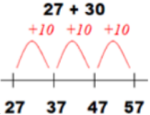

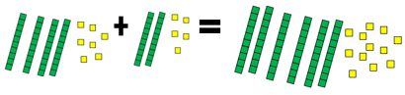


Progression in Teaching and Learning Addition: YEAR 2
Year 2 Objectives | Add and subtract across 10. Recall and use addition facts to 20 fluently, and derive and use related facts up to 100. Recognise the subtraction structure of ‘difference’ and answer questions of the form ‘How many more…?’ Add and subtract numbers using concrete objects, pictorial representation, and mentally, including: a 2-digit number and ones, a 2-digit number and tens, two 2-digit numbers, three 1-digit numbers. Add and subtract within 100 by applying related 1-digit addition and subtraction facts; add and subtract only ones or only tens to/from a 2-digit number. Add and subtract within 100 by applying related 1-digit addition and subtraction facts; add and subtract any two 2-digit numbers.
Strategy | Enactive | Iconic | Symbolic
Add a 2-digit number and tens | 25 + 10 = 35 Explore that the ones digit does not change. |  | 27 + 10 = 37 27 + 20 = 47 27 + = 57
Add two 2-digit numbers |  | 47 + 25 Use number line and bridge 10 using part-whole if necessary. | 47 + 25 = 47 + 20 + 5 = 67 + 5 = 72
Add three 1-digit numbers | 4 + 7 + 6 = 17 | 4 + 7 + 6 = 17 Draw a picture to recombine the groups to make 10. | Combine the 2 numbers that make / bridge 10 then add on the third.
Counting on in tens first, then ones.
47 + 25 = 67 + 5 = 72
=
Combine to make 10 first if possible or bridge 10 then add third digit.

Slide 9

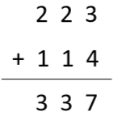
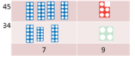
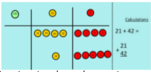
Progression in Teaching and Learning Addition: YEAR 3
Year 3 Objectives | Calculate complements to 100. Add and subtract numbers with up to 3-digits, using formal written method of columnar addition and subtraction. Add and subtract up to 3-digit numbers using columnar methods. Manipulate the additive relationship; understand the inverse relationship between addition and subtraction, and how both relate to the part-part-whole structure; understand and use the commutative property of addition, and understand the related property for subtraction.
Strategy | Enactive | Iconic | Symbolic
Add two/three 2-/3-digit numbers Column addition – no regrouping |  | Children can draw a pictorial representation of the columns and place value counters or Dienes.
10
1
Add the ones first, then the tens, then the hundreds.
Model using Dienes or Numicon.
Add together the ones first, then the tens.
10
1
223 | 114
Move to using place value counters.

Slide 10
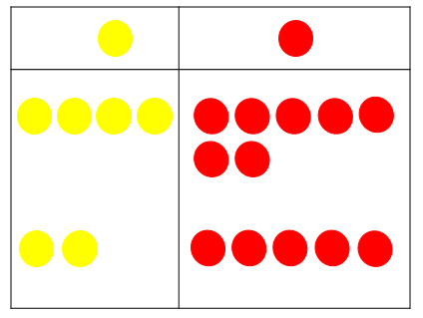
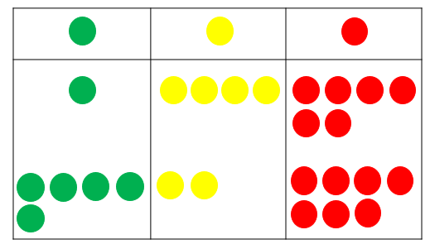
Progression in Teaching and Learning Addition: YEAR 3
Year 3 Objectives | Calculate complements to 100. Add and subtract numbers with up to 3-digits, using formal written method of columnar addition and subtraction. Add and subtract up to 3-digit numbers using columnar methods. Manipulate the additive relationship; understand the inverse relationship between addition and subtraction, and how both relate to the part-part-whole structure; understand and use the commutative property of addition, and understand the related property for subtraction.
Strategy | Enactive | Iconic | Symbolic
Add two/three 2-/3-digit numbers Column addition with regrouping | 47 + 25 Model using place value counters. Start with the ones. Exchange 10 counters from one column for one counter in the next column. “I’ve got more than 9 ___ here so I must exchange 10 ___ for 1 ___.” | Children can draw a pictorial representation of the columns and place value counters. | 47 + 25 Moving to 4 7 + 2 5 7 2
 | 146 + 527 Model using place value counters. Start with the ones. Exchange 10 counters from one column for one counter in the next column. “I’ve got more than 9 ___ here so I must exchange 10 ___ for 1 ___.” | Children can draw a pictorial representation of the columns and place value counters. | 146 + 527 1 4 6 + 5 2 7 6 7 3
47 | 25
Continue to use the talk frame.
Remind to line up digits of the same value. They should record the exchanging underneath the line.
40 + 7
+ 20 + 5
60 + 12 = 72
They should record the exchanging underneath the line.
“I’ve got more than 9 ___ here so I must exchange 10 ___ for 1 ___.”
7 2
1
Continue to use the talk frame for exchanging and reinforce ‘5 hundreds’, ‘2 tens’ and ‘7 ones’.
Remind to line up digits of the same value.
They should record the exchanging underneath the line.
146 | 527
1
See notes above for language etc.
6 7 3

Slide 11
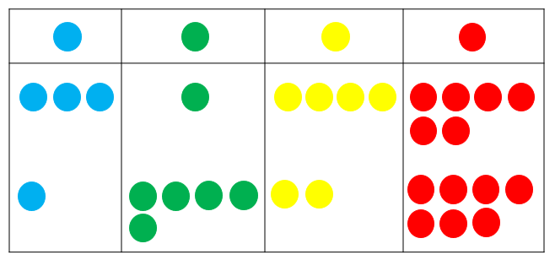
Progression in Teaching and Learning Addition: YEAR 4
Year 4 Objectives | Add and subtract numbers with up to 4-digits, using formal written method of columnar addition and subtraction where appropriate. Solve simple measure and money problems involving fractions and decimals to two decimal places (from fractions unit).
Strategy | Enactive | Iconic | Symbolic
Add numbers with up to 4-digits using a column method Relate to money and measures Include adding more than 2 numbers Move to selecting numbers when more than 1 exchange is necessary | 3146 + 1527 Model using place value counters. Start with the ones. Exchange 10 counters from one column for one counter in the next column. “I’ve got more than 9 ___ here so I must exchange 10 ___ for 1 ___.” | Children can draw a pictorial representation of the columns and place value counters. They should record the exchanging underneath the line. “I’ve got more than 9 ___ here so I must exchange 10 ___ for 1 ___.” | 3146 + 1527 3 1 4 6 + 1 5 2 7 4 6 7 3
 | Move to adding decimals (same number of digits after the decimal point) in the context of money when completing the fractions unit. Place value counters or coins can be used to support learning.
1
Continue to use the talk frame for exchanging and reinforce ‘1 thousand’, ‘5 hundreds’, ‘2 tens’ and ‘7 ones’.
Remind to line up digits of the same value.
They should record the exchanging underneath the line.
4 6 7 3
3146 | 1527

Slide 12
Progression in Teaching and Learning Addition: YEARS 5 & 6
Year 5 Objectives | Add and subtract whole numbers with more than 4-digits, including using formal written methods. Solve problems involving number up to three decimal places.
Year 6 Objectives | Understand that 2 numbers can be related additively or multiplicatively, and quantify additive and multiplicative relationships (multiplicative relationships restricted to multiplication by a whole number). Use a given additive or multiplicative calculation to derive or complete a related calculation, using arithmetic properties, inverse relationships, and PV understanding. Solve addition and subtraction multi-step problems in contexts, deciding which operations and methods to use and why.
Strategy | Enactive | Iconic | Symbolic
Add numbers with more than 4-digits or up to 3 decimal places using a column method Relate to money and measures Include adding more than 2 numbers | Year 5: Continue to use counters for adding numbers up to 6-digits and decimals with up to 3 decimal places and a different number of digits after the decimal point. NB: Not necessary to use specific place value colours now. “I’ve got more than 9 ___ here so I must exchange 10 ___ for 1 ___.” | Children can draw a pictorial representation of the columns and place value counters. “I’ve got more than 9 ___ here so I must exchange 10 ___ for 1 ___.” | 5 8 3, 1 4 6 2 3 . 3 7 1 + 3 4 1, 5 2 7 + 9 . 8 0 0 9 2 4, 6 7 3 3 3 . 1 7 1 Remind children to line up the digits of the same value. When adding numbers with a different number of digits after the decimal point, place-holder zeros may be used.
 | Year 6: Continue to use counters for adding numbers up to 7-digits and decimals with up to 3 decimal places and a different number of digits after the decimal point. See above for additional notes. |  | 7, 5 8 3, 1 4 6 2 5 . 3 7 1 + 6, 3 4 1, 5 2 7 9 . 8 0 0 1 3, 9 2 4, 6 7 3 + 5 6 . 6 2 0 9 1 . 7 9 1
1
1
1
1
23.371 | 9.8
25.371 | 9.8 | 56.62
1
1
2
1
See above for additional notes.

Slide 13
Progression in Teaching and Learning
Subtraction

Slide 14





Progression in Teaching and Learning Subtraction: EYFS
Guidance / Models / Images | Key Vocabulary
Children begin with mostly pictorial representations. Concrete apparatus is used to relate subtraction to taking away and counting how many objects are left. Concrete apparatus models the subtraction of 2 objects from a set of 5. Construct number sentences verbally or using cards to go with practical activities. Children are encouraged to read number sentences in different ways: “five subtract one leaves four”, “four is equal to five subtract one.” Children make a record in pictures, words or symbols of subtraction activities already carried out. Solve simple problems using fingers. Number tracks can be introduced to count back and to find one less. What is 1 less than 9? What is 1 less than 20? Use what is known about 1 less to compare 2 sets of numbers. Number lines can then be used alongside number tracks and practical apparatus to solve subtraction calculations and word problems. Children count back under the number line. 5-frames and 10-frames can also be used. Children will need opportunities to look at and talk about different models and images as they move between representations. | Games and songs can be a useful way to begin using vocabulary involved in addition, e.g. ‘Five little men in a flying saucer’. Take (away) Leave How many are left / left over? How many have gone? One less, two less, ten less How many fewer is … than …? Difference between Is the same as

Slide 15

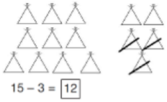



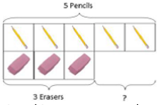


Progression in Teaching and Learning Subtraction: YEAR 1
Year 1 Objectives | Read, write and interpret equations containing addition (+), subtraction (-) and equals (=) symbols, and relate additive expressions and equations to real-life contexts. Read, write and interpret mathematical statements involving addition (+), subtraction (–) and equals (=) signs. Compose numbers to 10 from 2 parts, and partition numbers into parts, including recognising odd and even numbers. Represent and use number bonds and related subtraction facts within 20. Add and subtract one-digit and two-digit numbers to 20, including zero.
Strategy | Enactive | Iconic | Symbolic
Taking away ones | 6 – 4 = 2 4 – 2 = 2 Use physical objects, counters, cubes etc. to show how objects can be taken away. |  | 6 – 4 = 2 4 – 2 = 2 15 – 3 = 12
Counting back | Move objects away from the group, counting backwards. | Count back in ones using a number line. | 13 – 4 = 9 Put 13 in your head and count back 4. What number are you at?
Find the difference | Compare objects and amounts. 4 is 3 less than 7. |  | Hannah has 12 sweets and her sister has 5. How many fewer sweets does Hannah have than her sister?
Cross out drawn objects to show what has been taken away.
Move the beads along the bead string as you count backwards.
Count on using a number line to find the difference.

Slide 16
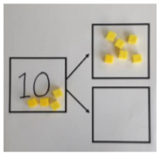
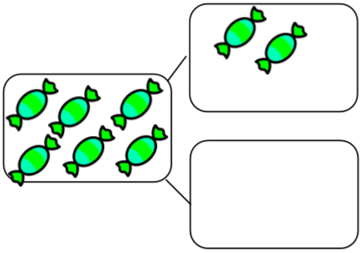
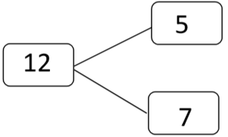


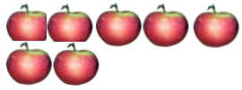


Progression in Teaching and Learning Subtraction: YEAR 1
Year 1 Objectives | Read, write and interpret equations containing addition (+), subtraction (-) and equals (=) symbols, and relate additive expressions and equations to real-life contexts. Read, write and interpret mathematical statements involving addition (+), subtraction (–) and equals (=) signs. Compose numbers to 10 from 2 parts, and partition numbers into parts, including recognising odd and even numbers. Represent and use number bonds and related subtraction facts within 20. Add and subtract one-digit and two-digit numbers to 20, including zero.
Strategy | Enactive | Iconic | Symbolic
Represent and use number bonds and related subtractions facts within 20 Part-part-whole model | If 10 is the whole and 6 is one of the parts, what is the other part?
Make 10 | 14 – 5 Make 14 on the ten frame. Take 4 away to make 10, then take one more away so that you have taken away 5. | 13 – 7 Jump back 3 first, then another 4. Use 10 as the stopping point. | 16 – 8 How many do we take off first to get to 10? How many left to take off?
Using a bar model to represent subtraction | 5 – 2 = 3 | 10 – 2 = 8 | 10 = 8 + 2 10 – 2 = 8 10 = 2 + 8 10 – 8 = 2
10 – 6 = 4
Link to addition. Use PPW model to model the inverse.
Use pictorial representations to show the part.
Move to using numbers within the part-whole model.

Slide 17
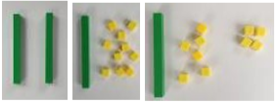

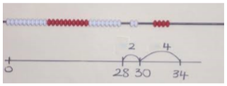

Progression in Teaching and Learning Subtraction: YEAR 2
Year 2 Objectives | Add and subtract across 10. Recall and use addition facts to 20 fluently, and derive and use related facts up to 100. Recognise the subtraction structure of ‘difference’ and answer questions of the form ‘How many more…?’ Add and subtract numbers using concrete objects, pictorial representation, and mentally, including: a 2-digit number and ones, a 2-digit number and tens, two 2-digit numbers, three 1-digit numbers. Add and subtract within 100 by applying related 1-digit addition and subtraction facts; add and subtract only ones or only tens to/from a 2-digit number. Add and subtract within 100 by applying related 1-digit addition and subtraction facts; add and subtract any two 2-digit numbers.
Strategy | Enactive | Iconic | Symbolic
Regroup a ten into ten ones | 20 – 4 Use a PV chart to show how to change a ten into 10 ones (‘take and make’). | 20 - 4 | 20 – 4 = 16
Partitioning to subtract without regrouping | 34 – 13 = 21 Use dienes to show how to partition the number. | 34 – 13 = 21 | 34 – 13 = 21
Counting on to find the difference / Make ten | 34 – 28 Use bead strings to model counting on to the next ten and the rest. | 34 – 28 93 - 76 | 93 – 76 = 17 Progression should be crossing one ten, crossing more than one ten, crossing the hundreds.
20
4
13
34
Children draw representations of Dienes to cross off.

Slide 18

Progression in Teaching and Learning Subtraction: YEAR 3
Year 3 Objectives | Calculate complements to 100. Add and subtract numbers with up to 3-digits, using formal written method of columnar addition and subtraction. Add and subtract up to 3-digit numbers using columnar methods. Manipulate the additive relationship; understand the inverse relationship between addition and subtraction, and how both relate to the part-part-whole structure; understand and use the commutative property of addition, and understand the related property for subtraction.
Strategy | Enactive | Iconic | Symbolic
Column subtraction without regrouping | 47 – 32 Use base 10 or Numicon to model. Move to using place value counters. | 47 – 32 Draw represent- ations of base 10. | 47 – 32 Leading to 4 7 - 3 2 1 5
Column subtraction with regrouping | 44 – 27 Begin with base 10 or Numicon. Move to PV counters, modelling the exchange of a ten into 10 ones. Start with the ones. | 44 – 27 Children may draw base ten or PV counters (see over page) to cross off. | 44 – 27 Leading to 4 4 - 2 7 1 7 Remind to line up digits of the same value.
This intermediate step may be needed to lead to clear subtraction understanding.
40 + 7
- 30 + 2
10 + 5 = 15
47
32
30
This intermediate step may be needed to lead to clear subtraction understanding.
1
40 + 4
- 20 + 7
10 + 7 = 17
3
1
44
27

Slide 19
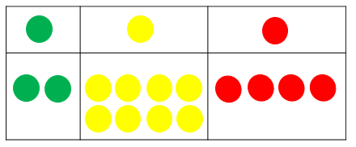
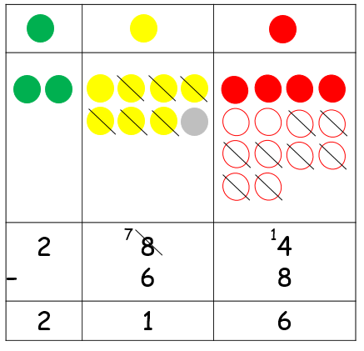
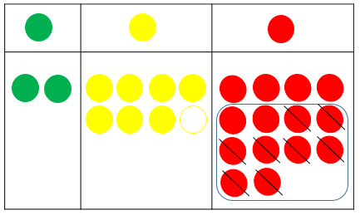
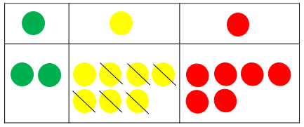
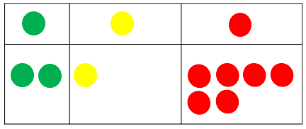
Progression in Teaching and Learning Subtraction: YEAR 3
Year 3 Objectives | Calculate complements to 100. Add and subtract numbers with up to 3-digits, using formal written method of columnar addition and subtraction. Add and subtract up to 3-digit numbers using columnar methods. Manipulate the additive relationship; understand the inverse relationship between addition and subtraction, and how both relate to the part-part-whole structure; understand and use the commutative property of addition, and understand the related property for subtraction.
Strategy | Enactive | Iconic | Symbolic
Column subtraction with regrouping | 284 – 68 Make the larger number with the place value counters. Start with the ones. “I can’t do this without going into negative numbers so I must exchange 1 ___ for 10 ___.” Exchange 1 counter from one column for 10 counters in the previous column. | Children can draw a pictorial representation of the columns and place value counters, crossing out the counters as well as clearly showing the exchanges. | Continue to use the talk frame for exchanging and reinforce ‘2 hundreds’, ‘8 tens’ and ‘4 ones’. Remind to line up the digits of the same value. 2 8 4 - 6 8 2 1 6
7
1
“I can’t do this without going into negative numbers so I must exchange 1 ___ for 10 ___.”
“I can’t do this
without going into negative numbers
so I must exchange
1 ___ for 10 ___.”
284
 | 68

Slide 20
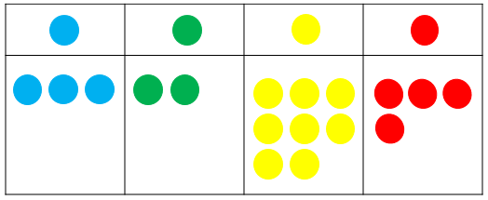
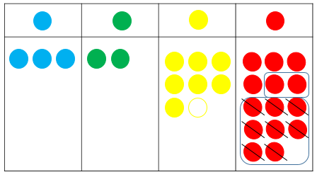
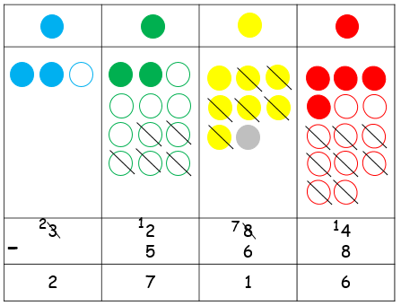
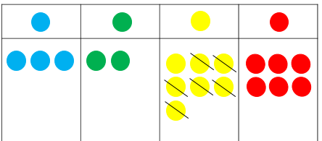
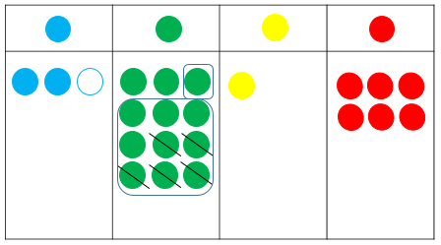
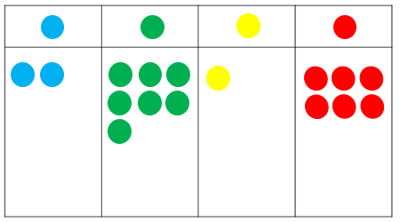
Progression in Teaching and Learning Subtraction: YEAR 4
Year 4 Objectives | Add and subtract numbers with up to 4-digits, using formal written method of columnar addition and subtraction where appropriate. Solve simple measure and money problems involving fractions and decimals to two decimal places (from fractions unit).
Strategy | Enactive | Iconic | Symbolic
Column subtraction with up to 4-digit numbers Relate to money and measures Move to selecting numbers when more than 1 exchange is necessary | 3284 – 568 Make the larger number with the place value counters. “I can’t do this without going into negative numbers so I must exchange 1 ___ for 10 ___.” | Children can draw a pictorial representation of the columns and place value counters, crossing out the counters as well as clearly showing the exchanges. “I can’t do this without going into negative numbers so I must exchange 1 ___ for 10 ___.” | Continue to use the language in the talk frame for exchanging and reinforce ‘3 thousands’, ‘2 hundreds’, ‘8 tens’ and ‘4 ones’. 3 2 8 4 - 5 6 8 2 7 1 6 “I can’t do this without going into negative numbers so I must exchange 1 ___ for 10 ___.” Remind children to line up the digits of the same value.
1
2
7
1
Exchange 1 counter from one column for 10 counters in the previous column.
Move to subtracting decimals (same number of digits
after the decimal point) in the context of money. Coins can be used to support learning.
3284
 | 568

Slide 21
Progression in Teaching and Learning Subtraction: YEARS 5 & 6
Year 5 Objectives | Add and subtract whole numbers with more than 4-digits, including using formal written methods. Solve problems involving number up to three decimal places.
Year 6 Objectives | Understand that 2 numbers can be related additively or multiplicatively, and quantify additive and multiplicative relationships (multiplicative relationships restricted to multiplication by a whole number). Use a given additive or multiplicative calculation to derive or complete a related calculation, using arithmetic properties, inverse relationships, and PV understanding. Solve addition and subtraction multi-step problems in contexts, deciding which operations and methods to use and why.
Strategy | Enactive | Iconic | Symbolic
Subtract numbers with more than 4-digits or up to 3 decimal places using a column method Relate to money and measures | Year 5: Continue to use counters for subtracting numbers up to 6-digits and decimals with up to 3 decimal places and a different number of digits after the decimal point. NB: Not necessary to use specific place value colours now. “I can’t do this without going into negative numbers so I must exchange 1 ___ for 10 ___.” | Children can draw a pictorial representation of the columns and place value counters. “I can’t do this without going into negative numbers so I must exchange 1 ___ for 10 ___.” | 4 8 3, 1 4 6 2 3 . 3 0 0 - 9 1, 5 2 7 - 9 . 8 1 4 3 9 1, 6 1 9 1 3 . 4 8 6 Where the exchange involves 1 or more zeros, show one less than the two or more combined digits.
 | Year 6: Continue to use counters for subtracting numbers up to 7-digits and decimals with up to 3 decimal places and a different number of digits after the decimal point. See above for additional notes. |  | 7, 5 8 0, 0 4 6 - 3 4 1, 5 7 4 7, 2 3 8, 4 7 2 See above for additional notes.
3
1
2
1
3
1
1
1
1
1
2
2
9
Remind children to line up digits of the same value.
9.814
23.3
7,580,046
 | 341,574
7
9
9
1

Slide 22
Progression in Teaching and Learning
Multiplication

Slide 23





Progression in Teaching and Learning Multiplication: EYFS
Guidance / Models / Images | Key Vocabulary
The link between addition and multiplication can be introduced through doubling. If available, Numicon is used to visualise the repeated adding of the same number. These can then be drawn around or printed as a way of recording. Children begin with mostly pictorial representations. How many groups of 2 are there? Real life contexts and use of practical equipment to count in repeated groups of the same size. How many wheels are there altogether? How much money do I have? Count in twos, fives, tens both aloud and with objects. Children are given multiplication problems in a real life context. Children are encouraged to visualise the problem. How many fingers are there on two hands? How many sides are there on three triangles? How many legs are there on four ducks? Children are encouraged to read number sentences aloud in different ways: “five times two makes ten”, “ten is equal to five multiplied by two”. Children should be able to identify numbers as odd and even. | Lots of Groups of Times Multiply Multiplied by Multiple of Once, twice, three times, ten times … times as big/long/wide Repeated addition Double Odd Even

Slide 24
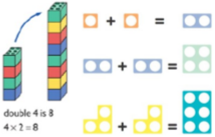
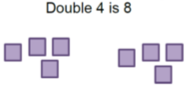
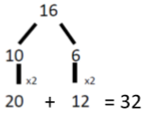
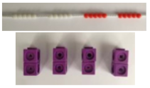


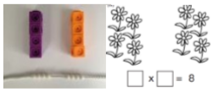
Progression in Teaching and Learning Multiplication: YEAR 1
Year 1 Objectives | Solve one-step problems involving multiplication, by calculating the answer using concrete objects, pictorial representations and arrays with the support of the teacher.
Strategy | Enactive | Iconic | Symbolic
Doubling |  | Draw pictures to show how to double numbers. | Partition a number and then double each part before recombining it back together.
Counting in multiples |  | Make representations to show counting in multiples. | Count in multiples of a number aloud. Write sequences with multiples of numbers. 2, 4, 6, 8, 10 5, 10, 15, 20, 25, 30
Making equal groups and counting the total | Use manipulatives to create equal groups. | Draw representations to show making equal groups. | 2 X 4 = 8
Use practical activities using manipulatives including cubes and Numicon to demonstrate doubling.
Count the
groups (skip counting). Children may use their fingers as they are skip counting.

Slide 25
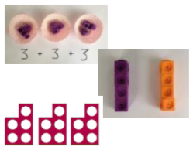
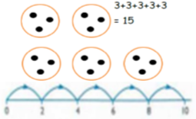

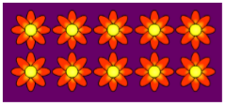
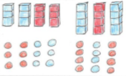
Progression in Teaching and Learning Multiplication: YEAR 1
Year 1 Objectives | Solve one-step problems involving multiplication, by calculating the answer using concrete objects, pictorial representations and arrays with the support of the teacher.
Strategy | Enactive | Iconic | Symbolic
Repeated addition | Use different objects to add equal groups. | Use pictures including number lines to show repeated addition. 2 X 5 2+2+2+2+2 There are 3 sweets in 1 bag. How many sweets are in 5 bags altogether? | Write addition number sentences to describe objects and pictures.
Understanding arrays | Use objects laid out in arrays to find the answers to 2 lots of 5, 3 lots of 2 etc. | Draw representations of arrays to show understanding. | 2 X 6 = 12 6 X 2 = 12 3 X 4 = 12 4 X 3 = 12
2 + 2 + 2 + 2 + 2 = 10

Slide 26
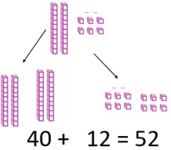



Progression in Teaching and Learning Multiplication: YEAR 2
Year 2 Objectives | Recall and use multiplication facts for the 2, 5 and 10 multiplication tables, including recognising odd and even numbers. Calculate mathematical statements for multiplication within the multiplication tables and write them using the multiplication (×) and equals (=) signs. Show that multiplication of 2 numbers can be done in any order (commutative). Solve problems involving multiplication, using materials, arrays, repeated addition, mental methods, and multiplication/division facts, including problems in contexts. Recognise repeated addition contexts, representing them with multiplication equations and calculating the product within the 2, 5 and 10 multiplication tables. Relate grouping problems where the number of groups is unknown to multiplication equations with a missing factor, and to division equations (quotitive division).
Strategy | Enactive | Iconic | Symbolic
Doubling |  |  | Partition a number and then double each part before recombining it back together.
Counting in multiples of 2, 3, 5, 10 from 0 (Repeated addition) | Count the groups (skip counting). Children may use their fingers as they are skip counting. | Number lines and bar models should be used to show representation of counting in multiples. | Count in multiples of a number aloud. Write sequences with multiples of numbers. 0, 2, 4, 6, 8, 10 0, 3, 6, 9, 12, 15 0, 5, 10, 15, 20, 25, 30 4 X 3 = 12
Model doubling using Dienes and PV counters.
2 X 26
Draw pictures and representations to show how to double numbers.
2 X 26
26
20
X2
6
X2
40 + 12 = 52
3 | 3 | 3 | 3

Slide 27









Progression in Teaching and Learning Multiplication: YEAR 2
Year 2 Objectives | Recall and use multiplication facts for the 2, 5 and 10 multiplication tables, including recognising odd and even numbers. Calculate mathematical statements for multiplication within the multiplication tables and write them using the multiplication (×) and equals (=) signs. Show that multiplication of 2 numbers can be done in any order (commutative). Solve problems involving multiplication, using materials, arrays, repeated addition, mental methods, and multiplication/division facts, including problems in contexts. Recognise repeated addition contexts, representing them with multiplication equations and calculating the product within the 2, 5 and 10 multiplication tables. Relate grouping problems where the number of groups is unknown to multiplication equations with a missing factor, and to division equations (quotitive division).
Strategy | Enactive | Iconic | Symbolic
Multiplication is commutative Pupils should understand that an array can represent different equations and that, as multiplication is commutative, the order of the multiplication does not affect the answer. | Create arrays using counters and cubes and Numicon. | Use representations of arrays to show different calculations and explore commutativity. | Use an array to write multiplication sentences and reinforce repeated addition. 15 = 5 X 3 15 = 3 X 5 3 + 3 + 3 + 3 + 3 = 15 5 + 5 + 5 = 15
Using the inverse This should be taught alongside division so children learn how they work alongside each other. |  |  | Show all 8 related fact family number sentences: 2 X 4 = 8 8 = 2 x 4 4 X 2 = 8 8 = 4 x 2 8 ÷ 2 = 4 4 = 8 ÷ 2 8 ÷ 4 = 2 2 = 8 ÷ 4

Slide 28






Progression in Teaching and Learning Multiplication: YEAR 3
Year 3 Objectives | Recall and use multiplication facts for the 3, 4 and 8 multiplication tables. Apply known multiplication and division facts to solve contextual problems with different structures, including quotitive and partitive division. Calculate mathematical statements for multiplication using the multiplication tables they know, including for 2-digt X 1-digit numbers, using mental and progressing to formal written methods.
Strategy | Enactive | Iconic | Symbolic
Grid method | Show the link with arrays to first introduce the grid method. 4 X 13 4 rows of 10 & 4 rows of 3 Move to base 10 for a more compact method. 3 X 24 Move to using PV counters. Each row has Add up each column, starting with the ones making any exchanges needed, and find the total. | Children can draw the counters, using colours to show different amounts or just use circles in the different columns to show their thinking. Bar models are used to explore missing numbers. | Use the grid to multiply the digits and show the clear addition alongside the grid. Start with the ones. 60 + 12 =72
Start with the ones.
10
1

Slide 29



Progression in Teaching and Learning Multiplication: YEAR 4
Year 4 Objectives | Multiply and divide whole numbers by 10 and 100 (keeping to whole number quotients); understand this as equivalent to making a number 10 or 100 times the size. Manipulate multiplication and division equations, and understand and apply the commutative property of multiplication. Understand and apply the distributive property of multiplication. Multiply 2-digit and 3-digit numbers by a 1-digit number using formal written layout.
Strategy | Enactive | Iconic | Symbolic
Grid method | Use place value counters. Each row has 126. Add up each column, starting with the ones, making any exchanges needed, and find the total. | Children can draw the counters, using colours to show different amounts or just use circles in the different columns to show their thinking. 4 X 126 400 + 80 + 24 = 504 | Use the grid to multiply the digits and show the clear addition alongside the grid. Start with the ones. 4 X 126 400 + 80 + 24 = 504
Start
with the ones.

Slide 30
Progression in Teaching and Learning Multiplication: YEAR 4
Year 4 Objectives | Multiply and divide whole numbers by 10 and 100 (keeping to whole number quotients); understand this as equivalent to making a number 10 or 100 times the size. Manipulate multiplication and division equations, and understand and apply the commutative property of multiplication. Understand and apply the distributive property of multiplication. Multiply 2-digit and 3-digit numbers by a 1-digit number using formal written layout.
Strategy | Enactive | Iconic | Symbolic
Column multiplication | Counters can be used (as on the previous page) to lead to the use of the column method. | Pictures of the counters and the grid method (see previous page) can be used to lead to the use of the column method. 4 X 126 400 + 80 + 24 = 504 The bar model can support understanding. | Use the expanded column method, making links to the grid method. Start with multiplying the ones. 1 2 6 X 4 2 4 8 0 4 0 0 5 0 4
 |  |  | Move to the compact column method, making links to the grid method. Start with the ones. 1 2 6 X 4 5 0 4 Reinforce ‘1 hundred’, ‘2 tens’ and ‘6 ones’.
1
504
126 | 126 | 126 | 126
1
2

Slide 31

Progression in Teaching and Learning Multiplication: YEARS 5 & 6
Year 5 Objectives | Multiply and divide numbers by 10 and 100; understand this as equivalent to making a number 10 or 100 times the size, or 1 tenth or 1 hundredth times the size. Find factors and multiplies of positive whole numbers, including common factors and common multiples, and express a given number as a product of 2 or 3 factors. Multiply any whole number with up to 4-digits by any 1-digit number using a formal written method. Multiply numbers up to 4-digits by a 1-or 2-digit number using a formal written method, including long multiplication for 2-digit numbers.
Year 6 Objectives | Understand that 2 numbers can be related additively or multiplicatively, and quantify additive and multiplicative relationships (multiplicative relationships restricted to multiplication by a whole number). Use a given additive or multiplicative calculation to derive or complete a related calculation, using arithmetic properties, inverse relationships, and PV understanding. Multiply multi-digit numbers up to 4-digits by a 2-digit whole number using the formal written method of long multiplication. Multiply 1-digit numbers with up to 2dp by whole numbers.
Strategy | Enactive | Iconic | Symbolic
Column multiplication | Continue to use counters for multiplying numbers up to 4-digits by a 1-or 2-digit number. NB: Not necessary to use specific place value colours now. | Children can draw the counters, using colours to show different amounts or just use circles in the different columns to show their thinking. This can lead to use of the grid method. 18 X 1342 Find the total of each box. The bar model can support understanding. | This leads to the compact column method, making links to the grid method. 1 3 4 2 X 1 8 1 0 7 3 6 1 3 4 2 0 2 4 1 5 6
Column multiplication with decimal numbers (Year 6) |  |  | 1 3 4 2 X 1 . 8 1 0 7 3 . 6 1 3 4 2 . 0 2 4 1 5 . 6
Multiply the top number by the ones digit first.
Colour coding of the ones and tens digits and rows might support understanding.
“The one in 18 is a tens digit so I must put a zero in the ones place.”
2
3
1
1
The digits of the same value are not lined up here in the setting out of the calculation but are underneath this.
1342 | 1342 | 1342 | 1342 | 1342 | 1342 | 1342 | 1342 | 1342
1342 | 1342 | 1342 | 1342 | 1342 | 1342 | 1342 | 1342 | 1342
2
3
1
1

Slide 32
Progression in Teaching and Learning
Division

Slide 33


Progression in Teaching and Learning Division: EYFS
Guidance / Models / Images | Key Vocabulary
The ELG states that children should solve problems including doubling, halving and sharing. Children need to see and hear representations of division as both grouping and sharing. Division can be introduced through halving. Children begin with mostly pictorial representations linked to real life contexts. Grouping model: Mum has 6 socks. She grouped them into pairs. How many pairs did she make? Sharing model: I have 10 sweets. I want to share them with my friend. How many will we each have? Children have a go at recording the calculation that has been carried out. | Halve Share, share equally One each, two each, three each… Group in pairs, threes, tens… Equal groups of Divide Divided by Divided into Left, left over
Fractions Although not explicit in the Development Matters document, the sharing model is a useful way of introducing young children to fractions and calculating with fractions. Setting the problems in real life contexts and solving them with concrete apparatus will support children’s understanding. “I have got 5 bones to share between my 2 dogs. How many bones will they each get?” Children have a go at recording the calculation that has been carried out. | As division vocabulary plus the following: Fraction Half Halves Third Thirds
2 ½ + 2 ½ = 5

Slide 34



Progression in Teaching and Learning Division: YEAR 1
Year 1 Objectives | Solve one-step problems involving division, by calculating the answer using concrete objects, pictorial representations and arrays with the support of the teacher.
Strategy | Enactive | Iconic | Symbolic
Division as sharing (shared between) |  | Children should use pictures or shapes to share quantities. 8 shared between 2 is 4: 10 shared between 2 is 5: | 8 shared between 2 is 4 10 shared between 2 is 5
I have 10 cubes. Can you share them equally between 2?
5
5

Slide 35



Progression in Teaching and Learning Division: YEAR 2
Year 2 Objectives | Recall and use division facts for the 2, 5 and 10 multiplication tables, including recognising odd and even numbers. Calculate mathematical statements for division within the multiplication tables and write them using the division (÷) and equals (=) signs. Show that division of one number by another cannot be done in any order. Solve problems involving division, using materials, arrays, repeated addition, mental methods, and multiplication/division facts, including problems in contexts. Recognise repeated addition contexts, representing them with multiplication equations and calculating the product within the 2, 5 and 10 multiplication tables. Relate grouping problems where the number of groups is unknown to multiplication equations with a missing factor, and to division equations (quotitive division).
Strategy | Enactive | Iconic | Symbolic
Division as sharing (shared between) | 10 ÷ 2 = 5 |  | 8 ÷ 2 = 4 15 ÷ 5 = 3
Division as grouping (into groups of) using multiplication facts to support | Divide quantities into equal groups using cubes, counters or objects. | Use number lines for grouping. | 25 ÷ 5 = 5 How many groups of 5 are there in 25?
Children should use pictures or shapes to share quantities.
8 ÷ 2 = 4
I have 10 cubes. Can you share them equally between 2?
15
15 ÷ 5
= 3
Children should use bar modelling to show and support understanding.
10 ÷ 2 = 5
15 ÷ 5
= 3
35 ÷ 5 = 7
How many groups of 5 in 15?
15
5 | 5 | 5

Slide 36




Progression in Teaching and Learning Division: YEAR 3
Year 3 Objectives | Recall and use division facts for the 3, 4 and 8 multiplication tables. Apply known multiplication and division facts to solve contextual problems with different structures, including quotitive and partitive division. Calculate mathematical statements for division using the multiplication tables they know.
Strategy | Enactive | Iconic | Symbolic
Division as grouping (into groups of) | Divide quantities into equal groups using cubes, counters or objects. | Use number lines for grouping. | 28 ÷ 4 = 7 How many groups of 4 are there in 28?
Division with arrays |  | Draw an array and use lines to split the array into groups to make division and linked multiplication sentences. | Find the inverse of multiplication and division sentences by creating 8 linking number sentences. 3 X 5 = 15 15 = 3 X 5 5 X 3 = 15 15 = 5 X 3 15 ÷ 3 = 5 5 = 15 ÷ 3 15 ÷ 5 = 3 3 = 15 ÷ 5
12 ÷ 4 = 3
12 ÷ 3 = 4
How many groups of 3 in 12?
3 X = 12
24 ÷ 8 = 3
12
3 | 3 | 3 | 3
0
8
16
24
Link division to multiplication by
creating an array
and thinking about
the number
sentences that can be created.

Slide 37



Progression in Teaching and Learning Division: YEAR 3
Year 3 Objectives | Recall and use division facts for the 3, 4 and 8 multiplication tables. Apply known multiplication and division facts to solve contextual problems with different structures, including quotitive and partitive division. Calculate mathematical statements for division using the multiplication tables they know.
Strategy | Enactive | Iconic | Symbolic
Division with remainders | 14 ÷ 3 Divide objects into groups of 3 and see how much is left over. | Jump forward in equal jumps on a number line then see how many more you need to jump to find a remainder. 14 ÷ 3 How many 3s in 14? 3 fours with a remainder of 2 For larger numbers, when it becomes inefficient to count in single multiples, bigger jumps can be recorded using known facts. | Complete written divisions and show the remainder using ‘r’. 14 ÷ 3 = 4 r 2 dividend divisor quotient remainder
Draw
dots and
group
them.
Use a bar model.
14
3 | 3 | 3 | 3 | 2

Slide 38


Progression in Teaching and Learning Division: YEAR 4
Year 4 Objectives | Multiply and divide whole numbers by 10 and 100 (keeping to whole number quotients); understand this as equivalent to making a number 10 or 100 times the size. Manipulate multiplication and division equations, and understand and apply the commutative property of multiplication. Understand and apply the distributive property of multiplication. Divide 2-digit and 3-digit numbers by a 1-digit number using formal written layout.
Strategy | Enactive | Iconic | Symbolic
Short division method | 1) Short division: no remainder 639 ÷ 3 = 213 Divide the counters into groups of 3, starting with the largest place value. | Children can draw the counters, using colours to show different amounts or just use circles or dots in the different columns to show their thinking. Then they can draw around the circles to show them in groups. | Use the short division method alongside the counters. 639 ÷ 3 2 1 3 3 6 3 9
 | 2) Short division: end remainder 638 ÷ 3 = 212 r2 Divide the counters into groups of 3, starting with the largest place value. See how many ones are remaining. |  | Use the short division method alongside the counters. 638 ÷ 3 2 1 2 r 2 3 6 3 8
Start with the largest place value.
“There are __ groups of ___ in ___ hundreds / tens / ones.”
Start with the largest place value.
“There are __ groups of ___ in ___ hundreds / tens / ones. There are ___ ones remaining.”

Slide 39



Progression in Teaching and Learning Division: YEAR 4
Year 4 Objectives | Multiply and divide whole numbers by 10 and 100 (keeping to whole number quotients); understand this as equivalent to making a number 10 or 100 times the size. Manipulate multiplication and division equations, and understand and apply the commutative property of multiplication. Understand and apply the distributive property of multiplication. Divide 2-digit and 3-digit numbers by a 1-digit number using formal written layout.
Strategy | Enactive | Iconic | Symbolic
Short division method | 3) Short division: internal remainder 729 ÷ 3 = 243 “There are 2 groups of 3 hundred in 7 hundreds with 1 hundred remaining so I must exchange 1 hundred for 10 tens.” | Children can draw the counters, using colours to show different amounts or just use circles or dots in the different columns to show their thinking. Then they can draw around the circles to show them in groups. | Use the short division method alongside the counters. 729 ÷ 3 2 4 3 3 7 2 9
 | 4) Short division: first digit in dividend smaller than divisor 129 ÷ 3 “I must exchange 1 hundred for 10 tens.” |  | Use the short division method alongside the counters. 129 ÷ 3 0 4 3 3 1 2 9
Start with the largest place value.
“There are __ groups of ___ in ___ hundreds / tens / ones.”
1
“There is 1 hundred remaining so I must exchange 1 hundred for 10 tens.”
Start with the largest place value.
“I must exchange 1 hundred for 10 tens.”
1

Slide 40

Progression in Teaching and Learning Division: YEAR 5
Year 5 Objectives | Multiply and divide numbers by 10 and 100; understand this as equivalent to making a number 10 or 100 times the size, or 1 tenth or 1 hundredth times the size. Find factors and multiplies of positive whole numbers, including common factors and common multiples, and express a given number as a product of 2 or 3 factors. Divide numbers up to 4-digits by a 1-digit number using the formal written method of short division and interpret remainders appropriately for the context.
Strategy | Enactive | Iconic | Symbolic
Short division method | Continue to use counters for dividing numbers up to 4-digits by a 1-digit number. NB: Not necessary to use specific place value colours now. 1297 ÷ 3 = 432 r1 | Children can draw the counters, using colours to show different amounts or just use circles or dots in the different columns to show their thinking. | Use the short division method alongside the counters. 1297 ÷ 3 0 4 3 2 r1 3 1 2 9 7
“There are __ groups of ___ in ___ thousands / hundreds / tens / ones.”
1
“There is 1 thousand remaining so I must exchange 1 thousand for 10 hundreds.”
“There is 1 thousand remaining so I must exchange 1 thousand for 10 hundreds.”
“There are __ groups of ___ in ___ thousands / hundreds / tens / ones.”

Slide 41

Progression in Teaching and Learning Division: YEAR 6
Year 6 Objectives | Divide numbers up to 4-digits by a 2-digit number using the formal written method of short division where appropriate, interpreting remainders according to the context. Divide numbers up to 4-digits by a 2-digit whole number using the formal written method of long division, and interpret remainders as whole number remainders, fractions or by rounding, as appropriate for the context. Use written division methods in cases where the answer has up to 2dp.
Strategy | Enactive | Iconic | Symbolic
Short division method – expressing the remainder as a fraction or decimal | Continue to use counters for dividing numbers up to 4-digits by a 1-digit number. NB: Not necessary to use specific place value colours now. | Children can draw the counters, using colours to show different amounts or just use circles or dots in the different columns to show their thinking. | 1297 ÷ 3 0 4 3 2 r 3 1 2 9 7 Short division can be used in place of long division for any divisor. Start by recording the key multiples of the divisor (1X, 5X, 10X) and add further multiples as needed to support the calculation.
Short division method – resulting in a decimal | Use short division. Rather than expressing the answer with a remainder, extend the dividend with a decimal point and place holder zeros until there are no remainders.
“The divisor is 3 and the remainder is 1 so I can express this as a fraction as or as a decimal as .33 (to 2dp).”
1
511 ÷ 35

