Slide 1
Grammar Recap
Tell the person next to you what we were revising in the previous grammar lesson before the gameshow?

Slide 2
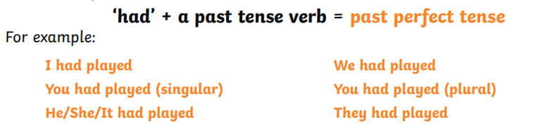

What tense is shown below?

Slide 3
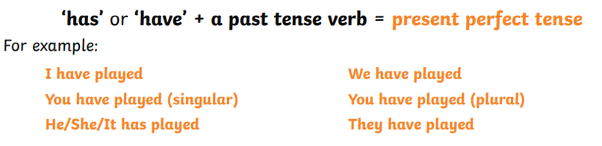
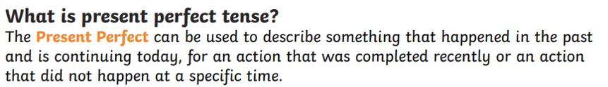
What tense is shown below?

Slide 4
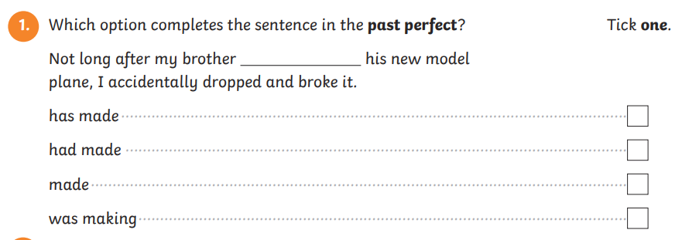
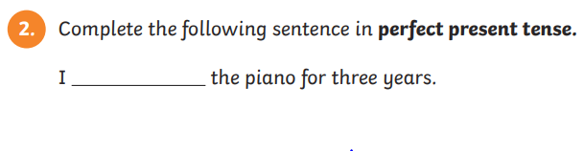
Types of tenses

Slide 5
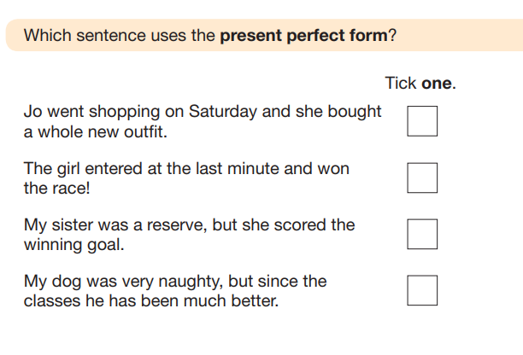

Slide 6
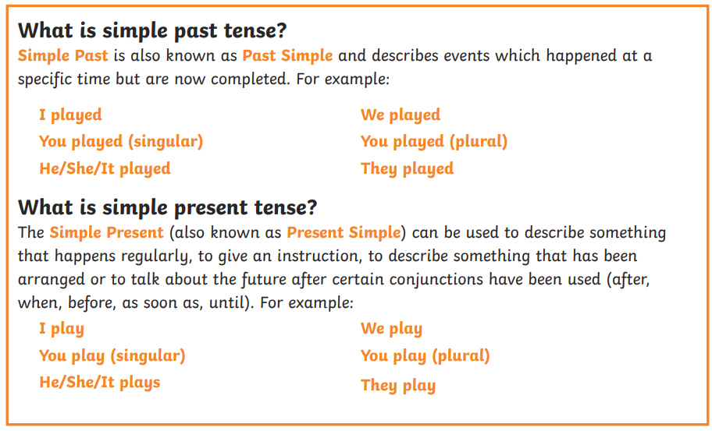
Types of tenses

Slide 7

What tense is shown below?
The teacher was teaching in a class.
He was eating food.
They were playing basketball after school.

Slide 8
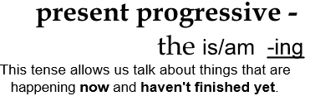
What tense is shown below?
I am eating fruit.
Ben is reading a book.
They are going to the office.

Slide 9
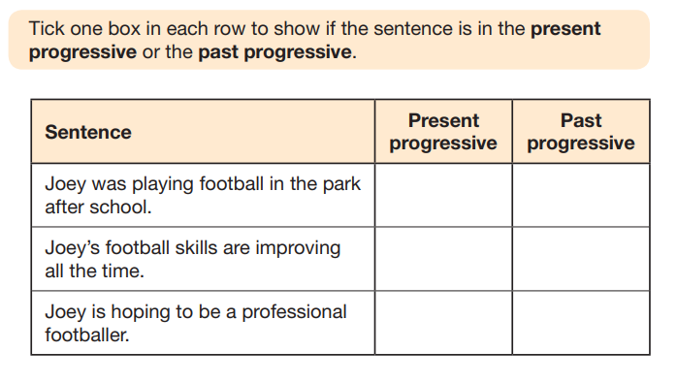

Slide 10
Grammar gameshow revision
There will be a gameshow competition based around these types of questions. Who will walk away with the prize…?

Slide 11
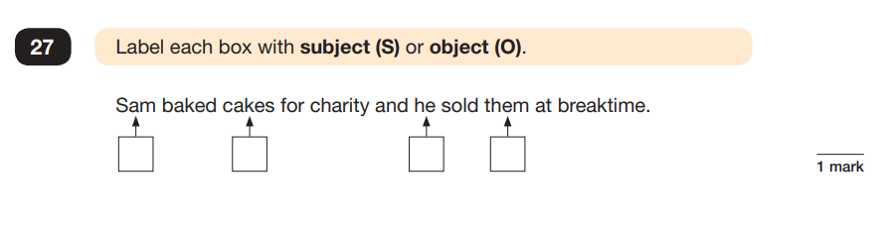
Subject/object
As a basic rule, the subject is the person or thing doing something. The object is having something done to it.
Mary caught a train to Liverpool to see her friend Lucy.

Slide 12
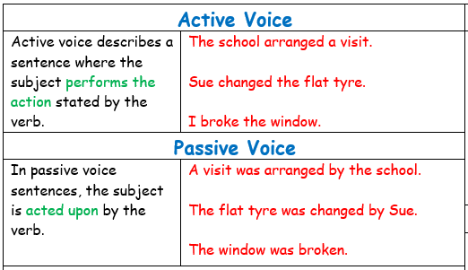

Slide 13
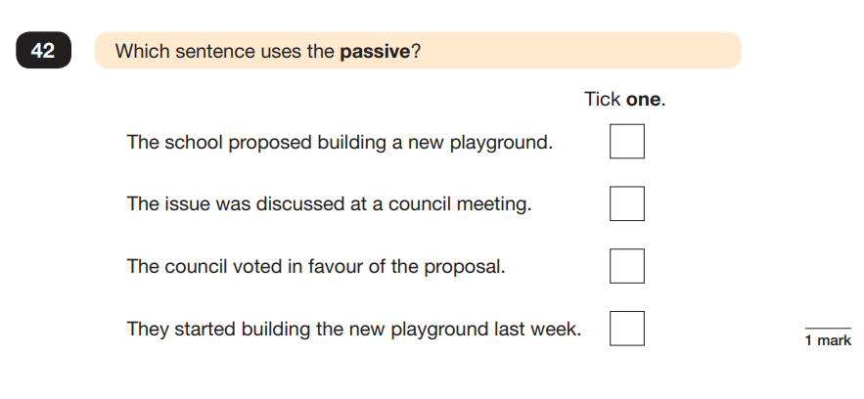
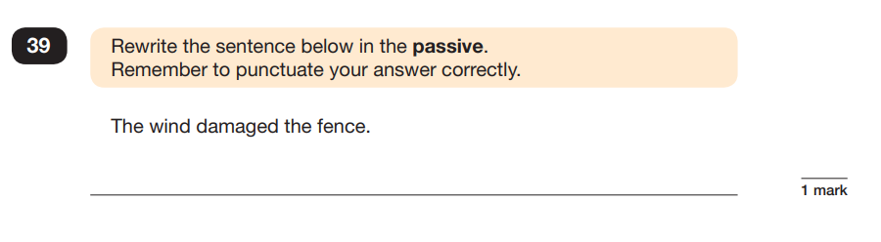
Passive voice
The passive voice is when the verb in the sentence is being done by the object to the subject. E.g. The man (subject) was chased (verb) by the dog (object).
Often the sentence will have was or by in.

Slide 14
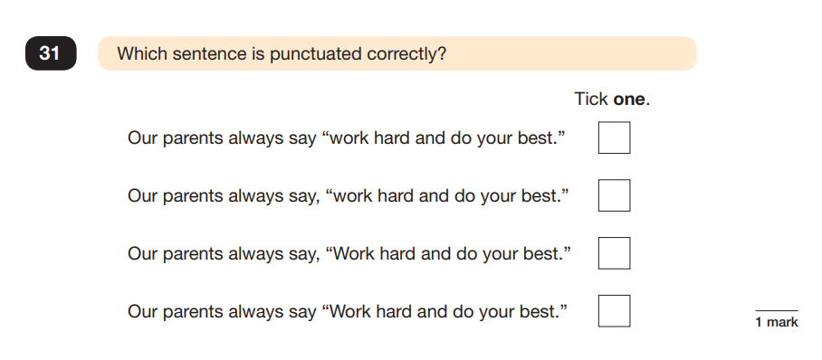
Speech
Write out and add in the correct punctuation to the speech below.
The teacher always shouts don’t forget to underline the date and title.

Slide 15
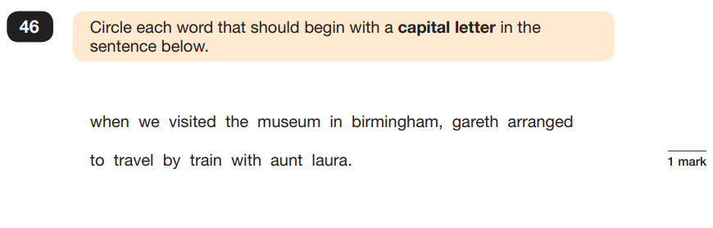
Inserting capital letters to a sentence
Remember that proper nouns (places and names of people) need capital letters.
Write the sentence out below inserting capital letters in the correct place.
on wednesday, auntie sandra flew from australia to england. She event flew of the pacific ocean.

