Slide 1
Comprehension Paper for KS2 SATS – Revision
3 mark questions
Remind the person next to you what you need to include in your answer to get 3 marks

Slide 2
3 mark questions – tips 1
Read the question carefully and look at what is it asking you. Make sure your answer is directly linking to the question.
If the question is asking you two/three points, make sure your individual point is clearly distinguished. Also, make sure your points are different.
Make sure your handwriting is clear and your sentences make sense. READ THROUGH YOUR WORK!

Slide 3
3 mark questions – tips 2
When referring to a character or the writer, avoid using ‘it’. Always use the name in your answer.
Support your points with an explanation. Your point can also be a quote from the text.
Normally making 2 points and supporting 1 with evidence is enough to get the three marks.

Slide 4
MINI EXTRACT - Example
Gazing at the wall in front of him, he was attempting to make the most of his free time on his first day of school. Even if he had to spend time on the bench alone, he knew that it would get better. Alfie was determined to overcome his eyes that had become full of tears. Suddenly, the bell rang. He had immense hope that he would make a friend during the next lesson.
Page 3

Slide 5
Example – three mark question
Question – Look at page 3. How is the boy made to seem upset? Explain two ways, giving evidence from the text to support your answer. (3 marks)
Look at what the question is asking you.
When you are giving your point, make sure you say why that makes the boy seem upset.
The question is asking for evidence.
Make sure your point is backed up with an explanation using information from the text. You can even use a quote to support your answer.

Slide 6
Example answer
From the text, the boy is shown sitting alone. This shows the boy may be upset as he has no friends and no one to talk to on his first day of school. It also says in the text that the boy’s eyes were ‘full of tears’. This shows that something or someone may have made the boy upset and made him cry.
- Point
- Explanation
This answer has given two points, both with an explanation to show how the point may have made the boy upset. Let’s see the mark scheme to see what marks the question will get!

Slide 7

Mark scheme
A two mark question will also need to be answered in a similar way. It will either ask you to give two answers or one answer with an explanation. This may not be specifically shown within the question but you can judge from the amount of marks the question is.

Slide 8
2017 Reading SATS

Slide 9
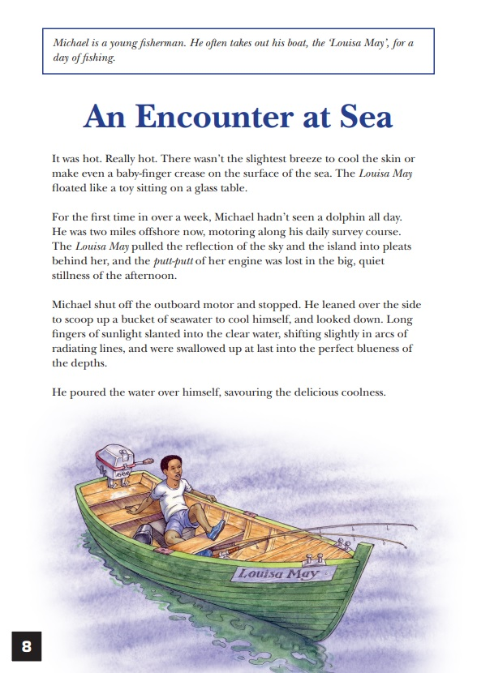
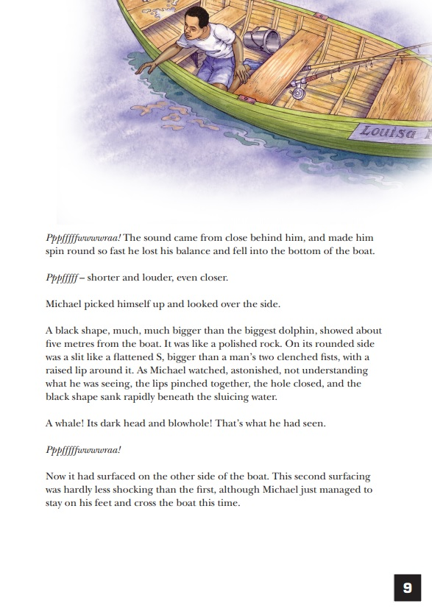

Slide 10
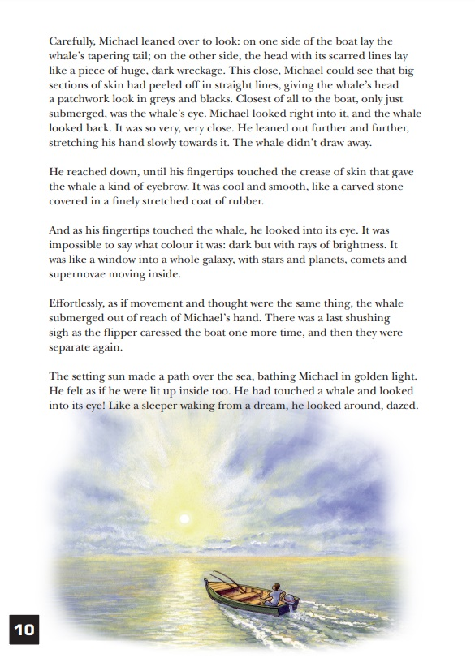
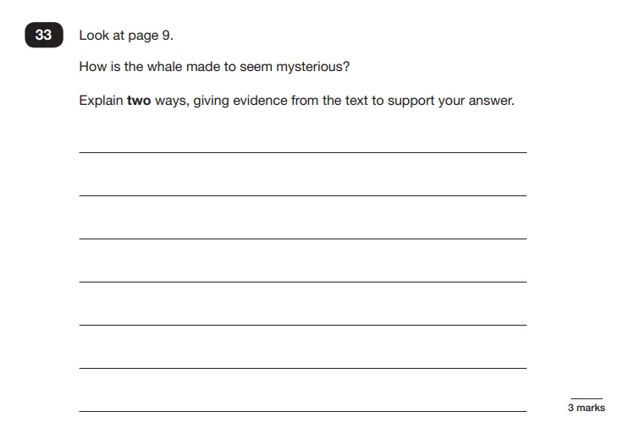
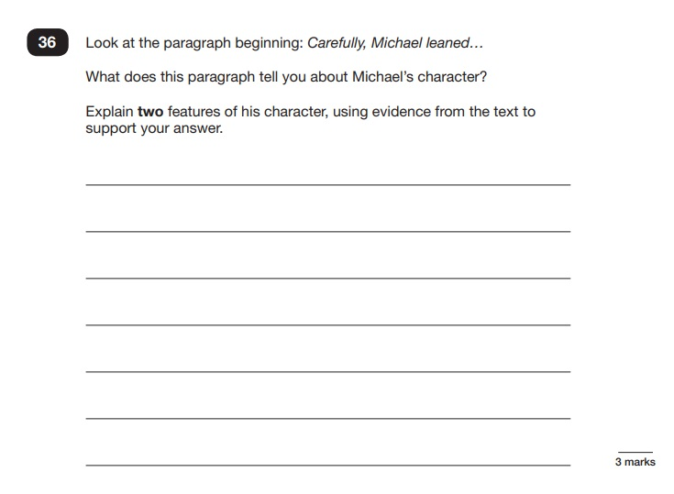

Slide 11
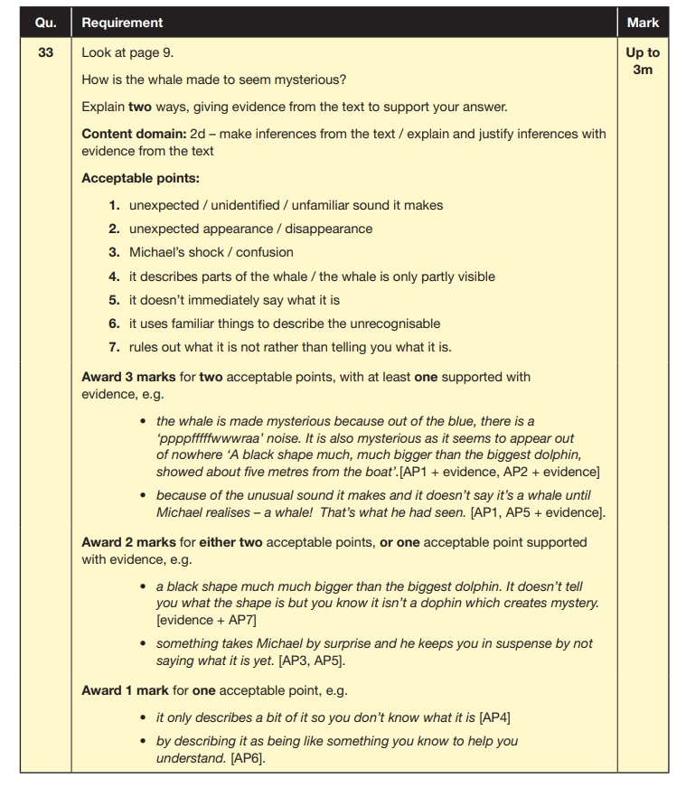

Slide 12
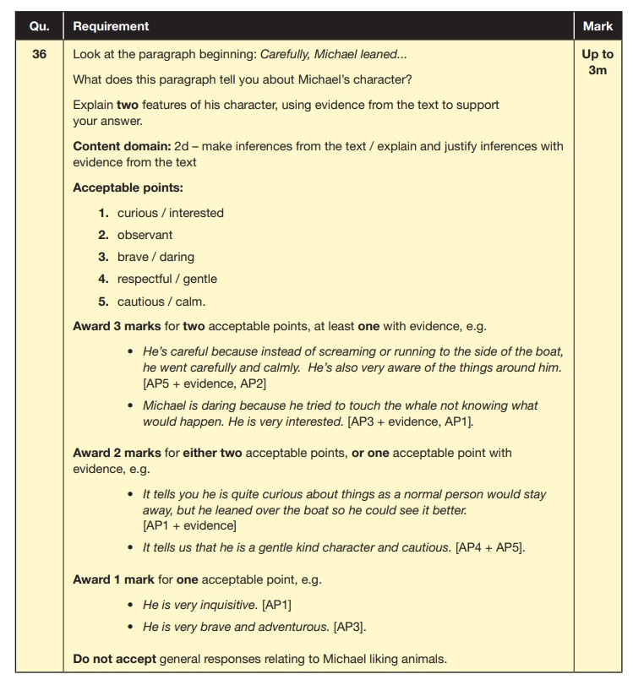

Slide 13
2018 Reading SATS

Slide 14
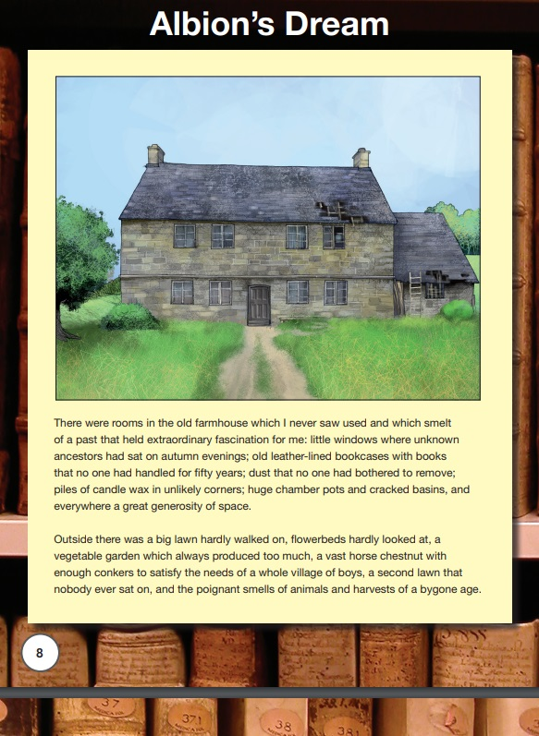
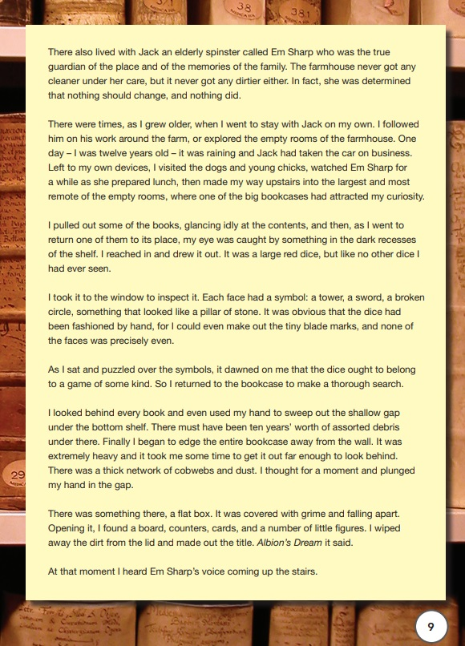

Slide 15
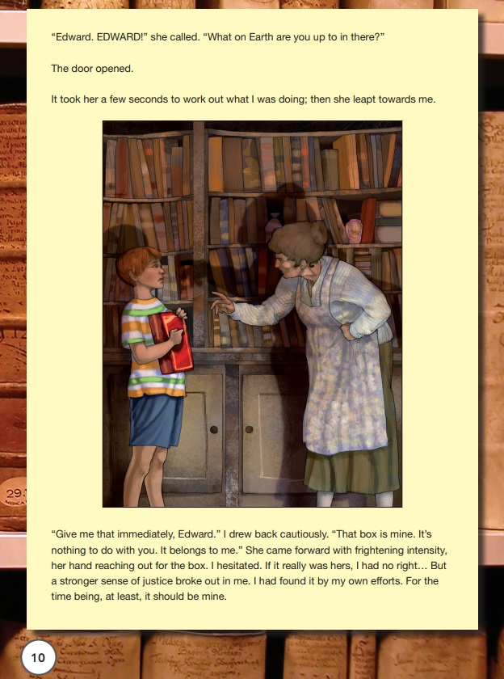
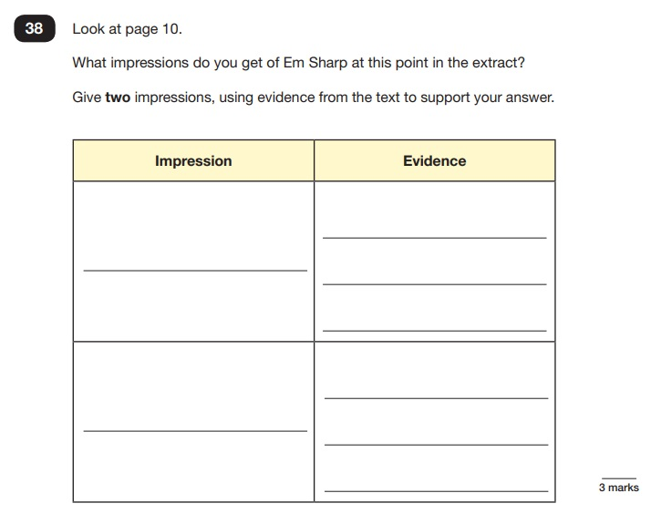
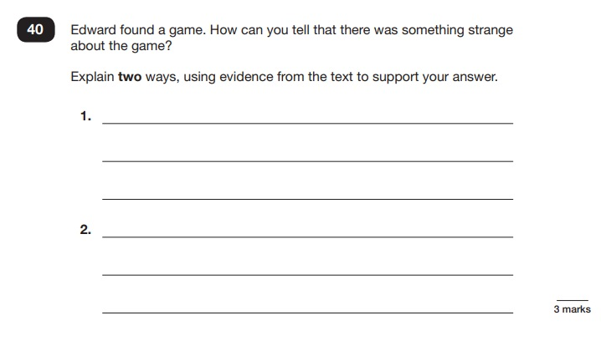

Slide 16
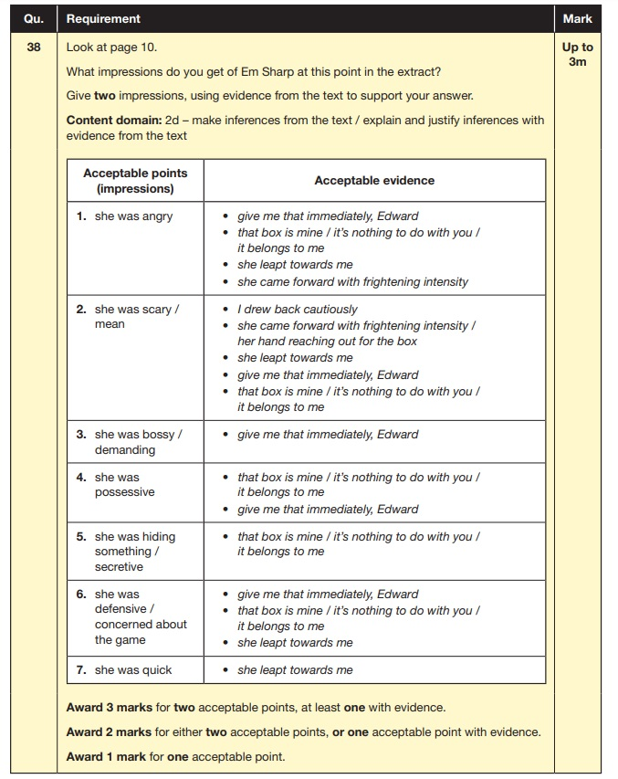

Slide 17
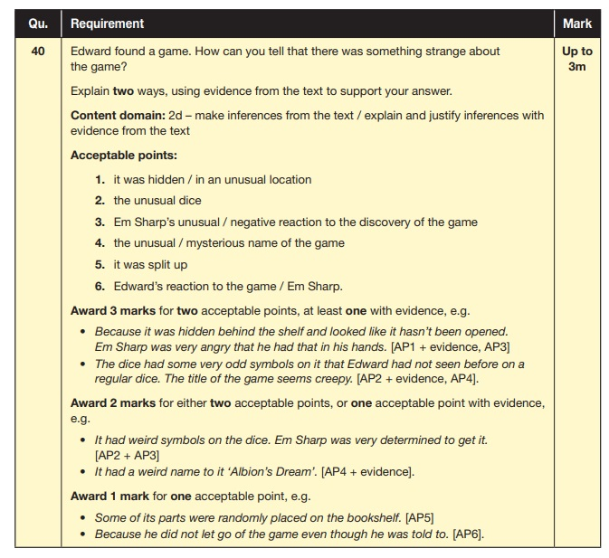

Slide 18
2019 Reading SATS

Slide 19
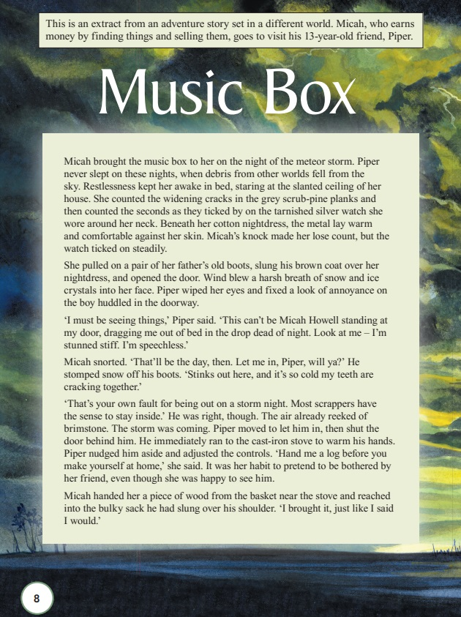
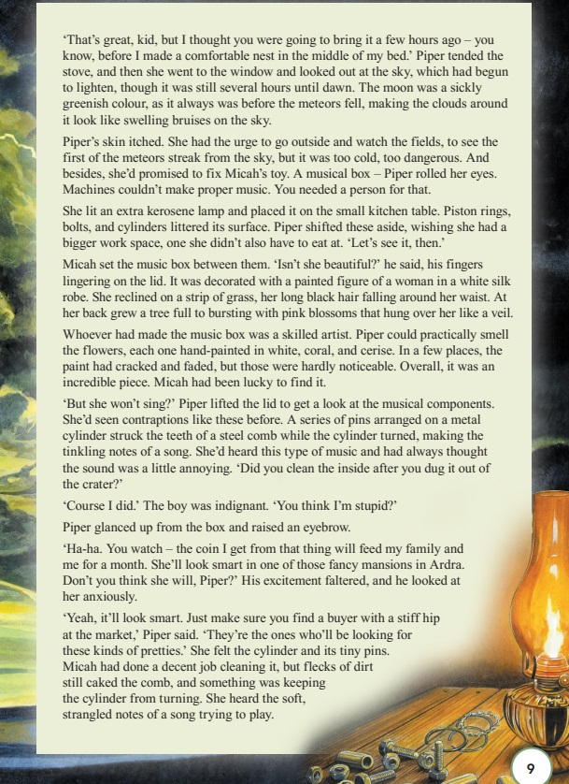

Slide 20
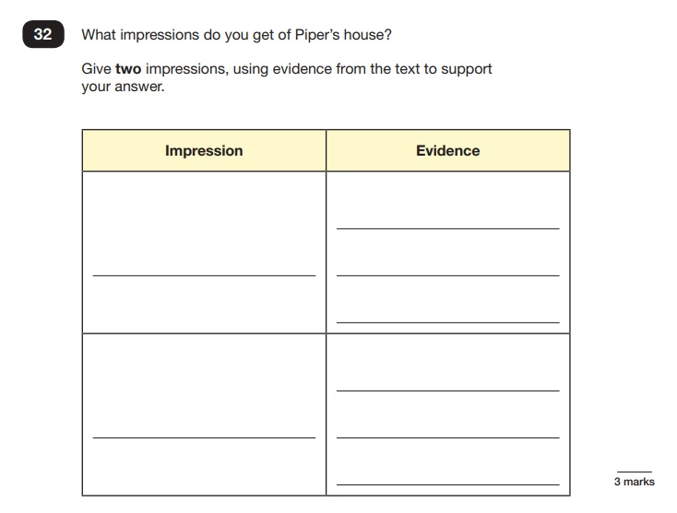
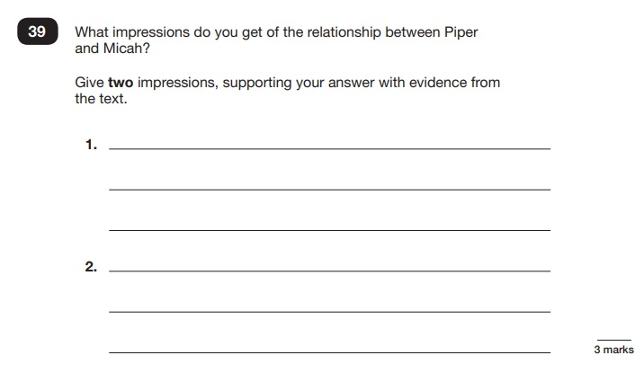

Slide 21
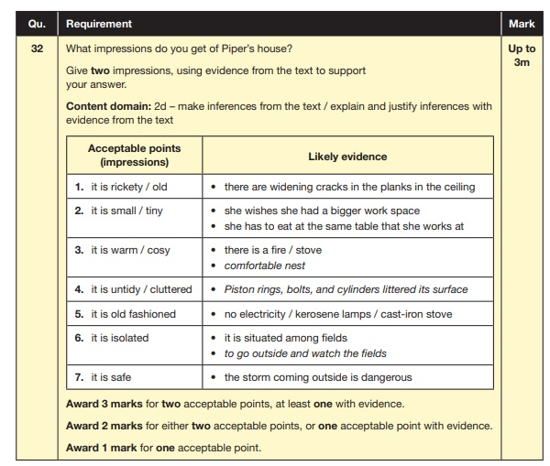

Slide 22


