Slide 1


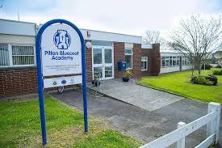
Pilton Bluecoat Academy
SEND Information Report
September 2025
“Building Brighter Futures”

Slide 2

Local Offer
SEND Policy
The Local Offer is a description of locally available provision across education, health and social care in Devon. It sets out what provision can be expected from schools, the Local Authority and other specialist services.
It is published online here:
Devon's SEND Local Offer
The SEND Policy is a description of the vision and values underpinning our approach to SEND.
It is published on the school’s website here:
Pilton Bluecoat C of E Academy - Special Educational Needs
SEN Information Report
The SEN Information Report clearly communicates how the school implements our SEND Policy and provides information on the types of support available for children at Pilton Bluecoat.
It is designed to provide information on who can help and how this help can be accessed.

Slide 3

Our School Vision
Nehemiah said “The people worked with all their hearts" (Nehemiah 4:6)
At Pilton Bluecoat, our vision of Building Brighter Futures is underpinned by the story of Nehemiah, who, when faced with the challenge of rebuilding Jerusalem’s wall, united people of all backgrounds, abilities, and differences to work side by side. As Nehemiah 4:6 says, "The people worked with all their hearts", and we live this out every day by showing care, support, and a deep commitment to one another, rooted in our school values: of love, hope, peace, perseverance, serving others, justice for others, and compassion.
We believe that Building Brighter Futures means providing every child with an exciting and engaging curriculum that supports their learning and growth, regardless of their starting point, and offers enriching experiences beyond the classroom. Through this, our pupils not only discover more about the world but also about themselves, always guided by the values that shape our school community.

Slide 4
Our Shared Vision for Inclusion
As a Trust, we embody the ethos of ‘Life, Love, and Learning to the Full’ which guides our journey towards providing a world-class education that cherishes every child and embraces the rich tapestry of global cultures.
At TEAM Multi-Academy Trust, we believe in nurturing not just the academic abilities of our children but also their emotional and social well-being within a supportive and positive environment. Our vision of ‘Life, Love, and Learning to the Full’ encapsulates our dedication to ensuring every child feels values, every learning opportunity is seized, and every day is a step towards a brighter, more inclusive future.
We take great pride in our achievements and the positive impact we’ve made on the lives of children in North Devon. Looking forward we remain dedicated to creating enriching experiences and lifelong memories for our children.
As a Trust, we strive to create inclusive teaching environments that offer all pupils, no matter their needs or abilities, access to a broad, balanced and challenging curriculum. We are committed to offering all pupils the chance to thrive and fulfil their aspirations.

Slide 5
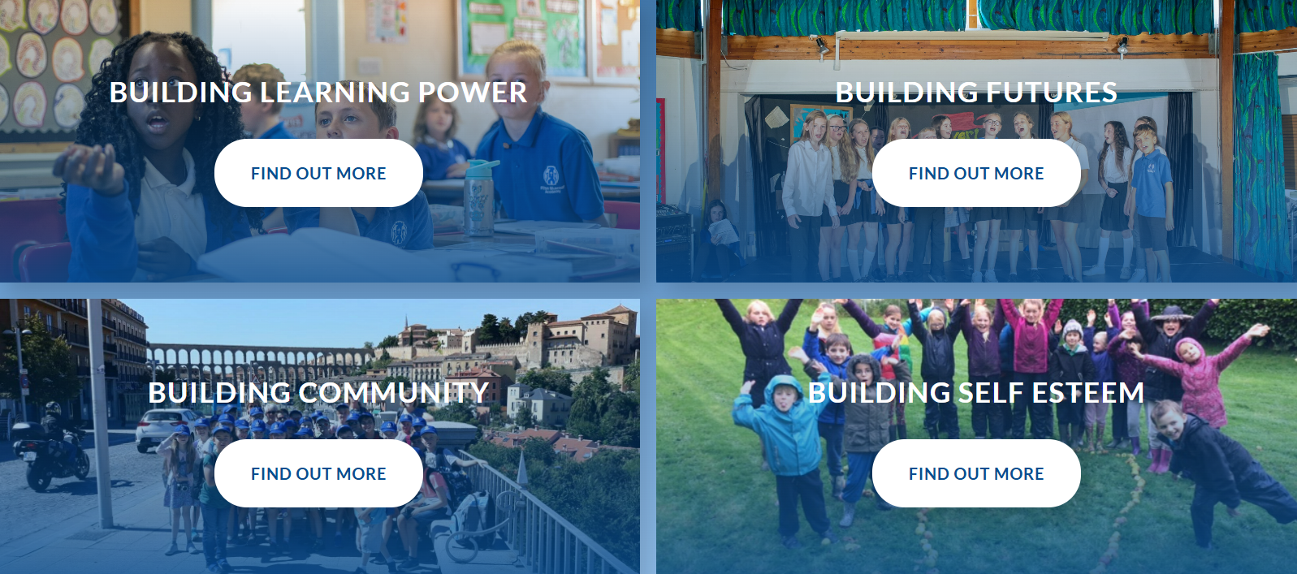
Our Drivers
Our Trust drivers provide us with a shared understanding and common purpose of what we want to achieve for all children, including those with SEND. We want children to be confident and resilient learners who understand their uniqueness, celebrate differences and are able to face challenges.
Please read on to find out more about how we use these drivers to support those with SEND.

Slide 6
Building Learning Power
At Pilton Bluecoat Academy, Building Learning Power is one of our key drivers, and the characteristics of effective learning are embedded throughout our school. We encourage curiosity, resilience, collaboration, and self-reflection in all pupils, helping them become confident, independent learners. For children with SEND, these skills are particularly important, as they support the development of strategies to overcome challenges, build confidence in their abilities, and engage fully with their learning. By nurturing these learning behaviours consistently, we ensure that every child is empowered to achieve their potential and approach new experiences with curiosity and determination.

Slide 7
Building Futures
At Pilton Bluecoat Academy, we are committed to Building Brighter Futures for all children, including those with SEND. Our passionate and dedicated staff carefully plan and prepare engaging educational experiences and opportunities that meet the needs of every pupil. Through tailored support plans, developed and regularly reviewed in partnership with staff, pupils, and families, we ensure that each child receives the guidance and resources they need to thrive. We also prioritise transitional work across schools and year groups, using collaborative planning and targeted activities to prepare children for each phase of their learning journey. By working closely together, we create an inclusive, nurturing environment where all children can achieve their potential, build confidence, and enjoy rich learning experiences that prepare them for the future.

Slide 8
Building Community
At Pilton Bluecoat Academy, building communities is a key thread woven throughout our curriculum. We provide opportunities for children to learn about their local area, the wider UK, Europe through Spain and Germany, and internationally through our partnership with India, helping them understand the world and their place within it. Students with SEND are fully supported to engage in all activities available to their peers, with individual arrangements and risk assessments planned in advance where needed. This ensures they can participate safely and meaningfully in trips, offsite activities, and extra-curricular events. By fostering inclusion and connection, we enable all children to develop a strong sense of community, empathy, and global awareness.

Slide 9
Building Self Esteem
At Pilton Bluecoat Academy, we recognise the importance of building self-esteem to help children access learning and celebrate their achievements. Through dedicated support plans, pupils with SEND receive tailored guidance that enables them to succeed academically and personally. Learning Champions engage in targeted activities to support their peers’ SEND needs, fostering confidence, skills, and a sense of accomplishment. The school also provides strong pastoral support to promote emotional and social development, including listening carefully to the views of children with SEND. By combining personalised learning, mentoring, and a nurturing environment, we ensure every child feels valued, supported, and empowered to thrive.

Slide 10

Ordinarily Available Inclusive Provision
Ordinarily Available Inclusive Provision (OAIP) describes the inclusive provision and practice that all Devon schools should be able to provide for all children, including those with SEND, from within their own resources.
All children should be supported to attend, engage and thrive in their school. The framework is intended to support schools to reflect on and develop their inclusive provision to benefit all children, including those with SEND.
The framework describes approaches, provision and practice that are helpful to all, harmful to none and crucial for some.
“We want all young people in Devon, including those who may have SEND, to have the right support at the right time and in the right place to help them achieve, aspire and develop well, physically, mentally and academically alongside their friends and peers.”
– Councillor Lois Samuel, the Council’s Cabinet Member for SEND Improvement
Ordinarily Available Inclusive Provision - Support for schools and settings

Slide 11

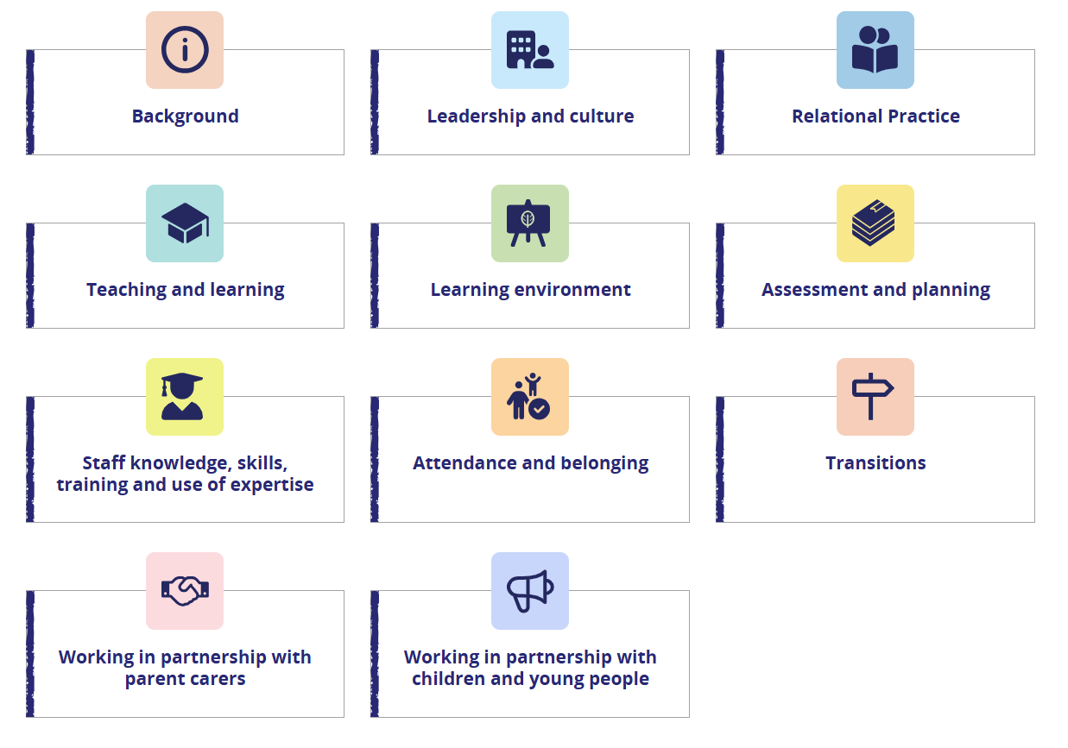
How will Pilton Bluecoat support my child?
The SEND Code of Practice is clear that a school’s SEN Information Report should be aligned to the expectations set out in the Local Offer.
Devon’s Ordinarily Available Inclusive Education Framework has also been designed to support schools to communicate their inclusive provision to children, parents and carers.
We have therefore decided to base our SEN Information Report around the ten areas that make up Devon’s Ordinarily Available Inclusive Education Framework to demonstrate how we support the children at Pilton Bluecoat.

Slide 12

Background
Other words that might be used interchangeably with OAIP include universal provision, inclusive practice and high quality teaching.
In Devon, we will be promoting consistent use of the terminology Ordinarily Available Inclusive Provision to avoid confusion and enable a shared understanding.
The framework recommends strategies that anticipate and therefore prevent common barriers to learning and supports the equity of access to education.
It also describes simple adjustments and additions teachers can make to their practice, to enable positive learning environments for all students.
These strategies will enable teachers to adapt their teaching to respond to the strengths and needs of all pupils.

Slide 13
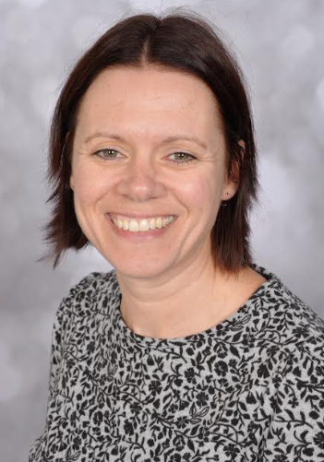

Leadership and Culture
For ALL children:
At Pilton Bluecoat Academy, leadership and culture are built on collaboration, inclusion, and partnership with families. We recognise the importance of working closely together to identify and meet the needs of every pupil. The Headteacher, senior leaders, SENDCO, pupil and parent worker collaborate to ensure all children are well supported, and they work alongside staff to empower them to meet the diverse needs of our learners. We strive to create a welcoming environment where everyone - children, families, and staff -feel valued, respected, and supported, fostering a positive culture that underpins learning and personal development for all.
Our school and trust leaders work towards this every day:
Mr Mat Harts, Head of School
Mr Ian Thomas, CEO, TEAM MAT
Mrs Beth Carter, Director of Inclusion, TEAM MAT
Mr Dan Polak, Director of Education, TEAM MAT
Leadership and culture - Support for schools and settings
For those with SEN:
Mrs Claire Jones Mrs Charlotte Barber
SENDCo Assistant SENDCo
01271 345952
office@piltonbluecoat.devon.sch.uk

Slide 14
Relational Practice
For ALL children:
At Pilton Bluecoat, we pride ourselves on fostering an inclusive and caring environment where every child feels valued and supported. Building safe, trusting relationships with pupils and their families is at the heart of our approach. We believe that strong connections create the foundation for learning and wellbeing. Our ordinarily available inclusive provision is embedded throughout the school and carefully adapted to meet the diverse needs of our learners. Through collaboration, empathy, and consistency, we ensure that every child has access to high-quality education and the opportunity to thrive.
Relational Practice - Support for schools and settings
For those with SEN:
For children who require support beyond our ordinarily available inclusive provision, we implement personalised Relational Support Plans and Co-Regulation Plans. These plans are designed collaboratively with staff, families, and where appropriate, the child, to ensure a consistent and nurturing approach. Relational Support Plans outline strategies to strengthen trust, emotional safety, and positive interactions, while Co-Regulation Plans provide practical steps for adults to help children manage heightened emotions and develop self-regulation skills over time. Both plans are dynamic and reviewed regularly to respond to the child’s evolving needs, ensuring that every learner feels understood, supported, and able to thrive within our school community.
Pilton Bluecoat C of E Academy - PILTON BLUECOAT POLICIES

Slide 15
Teaching and Learning
For ALL children:
At Pilton Bluecoat Academy, we support teaching and learning through clear curriculum mapping and carefully structured long, medium, and short-term planning, ensuring the accurate development and teaching of knowledge across all subjects. Individual support plans for children with SEND are fully integrated into this planning cycle, forming part of the ordinarily available provision so that all pupils can access the curriculum effectively. Our senior leaders and SENDCO closely monitor and support the progress of children through triangulated approaches, including observations, walkthrus coaching, and targeted CPDL for staff. This structured approach ensures high-quality teaching, consistent support, and the continual development of both pupils’ knowledge and staff expertise.
Teaching and learning - Support for schools and settings
For those with SEN:
Curriculum Adaptations: Lessons are adapted to remove barriers and ensure access for all learners.
Enhanced Provision: Support tailored to the four broad areas of SEND (Communication & Interaction, Cognition & Learning, SEMH, Sensory & Physical).
Inclusive Resources: Continued use of manipulatives, visuals, and scaffolds; resources chosen purposefully for individual needs.
Personalised Targets: Bespoke targets and support strategies aligned with individual plans.
Pupil Voice: Opportunities throughout the year for pupils to review and reflect on their learning targets.
Targeted Interventions: Focused support to address gaps, e.g., phonics, NumberSense, and fundamental movement groups.

Slide 16
Learning Environment
For ALL children:
We create calm, structured classrooms that support all learners by:
Explicit Vocabulary Teaching: Key vocabulary is taught and reinforced across subjects.
Reducing Cognitive Load: PowerPoints are simplified; classrooms remain tidy and uncluttered with displays kept within boards.
Celebrating Learning: Topic-based achievements are showcased on dedicated display boards.
Visual Supports: Class visual timetables, emotional thermometers, and consistent phonics “Grow the Code” displays are used throughout.
Consistency: Displays include Building Learning Power, Code of Conduct, and Class Charters to promote shared expectations.
Learning environment - Support for schools and settings
For those with SEN:
We provide tailored adjustments to ensure every child feels safe, comfortable, and ready to learn:
Adjusted Lighting: Classrooms are adapted to suit sensory needs.
Individual Seating: Seating arrangements are personalised for accessibility and focus.
Additional Adult Support: Targeted support is available both in and out of the classroom.
Small Group & Individual Work: Opportunities for focused learning in smaller settings.
Sensory Breaks: Access to the sensory trail for active brain breaks and regulation.
TEAM Accessibility Plan

Slide 17
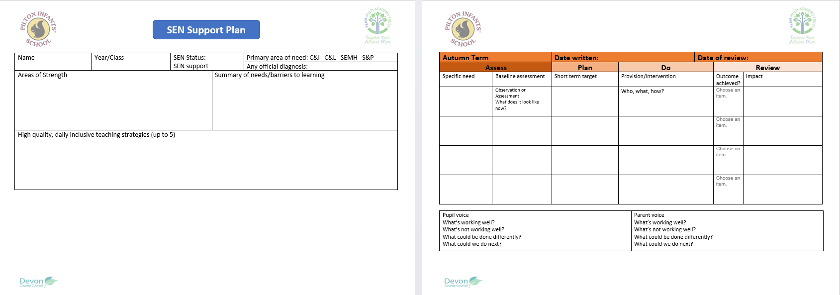
Assessment and Planning
For ALL children:
We use a range of strategies to monitor progress and inform next steps for all pupils:
Class Provision Maps: Track support and adaptations for individual and group needs.
Daily Formative Assessment: Embedded in English, Maths, and Dive Deeper tasks to check understanding.
Focused Practice: Arithmetic and maths fluency sessions; decision spelling elicitation and reviews; Quick Start reading; White Rose science retrieval activities.
Termly Assessments: Formal checks to monitor progress across subjects.
Statutory Assessments: SATs and Year 4 Multiplication Tables Check.
Summative Cornerstones Assessments: Conducted termly for Reading, Maths, and SPaG to inform planning and interventions.
Assessment and planning - Support for schools and settings
For those with SEN:
We have robust processes in place to assess and review progress towards individual outcomes:
Support Plans: Used to plan, monitor, and review provision as part of the APDR (Assess, Plan, Do, Review) cycle.
Termly Parent/Carer Meetings: Opportunities to review Support Plans, discuss progress, and agree new targets collaboratively.
Scaffolded Assessments: Adjustments such as readers, scribes, and assistive technology are provided where specific learning barriers are identified.
Use of Assessment Data: Outcomes from assessments inform subsequent planning, ensuring teaching and interventions remain responsive to individual needs.

Slide 18
Staff Knowledge, Skills, Training and Use of Expertise
For ALL children:
At Pilton Bluecoat Academy, our staff’s knowledge, skills, and expertise are central to delivering high-quality education. We maintain a current and coherent curriculum that builds on prior learning from Pilton Infants, ensuring that knowledge is sequenced and progressively developed. Dedicated staff work collaboratively on curriculum development across subjects, and we engage closely with senior leaders and staff within TEAM MAT to share best practice and drive continuous improvement. In addition, our Walkthrus coaching model supports teachers and cover supervisors in refining their practice, targeting learning gaps, and promoting consistent, evidence-informed teaching. This combination of expertise, ongoing training, and structured support ensures that all pupils have access to a rich and effective learning experience.
Staff knowledge, skills, training and use of expertise - Support for schools and settings
For those with SEN:
At Pilton Bluecoat C of E Academy, we are fortunate to have a highly skilled team with a range of in-house expertise, including:
Teaching Assistants with specialisms in Autism, Social, wellbeing support and Dyslexia
A pupil/parent pastoral worker
A dyslexia specialist teacher who offers termly support
When additional expertise is required, we work closely with Children and Family Health Devon, accessing services such as:
Occupational Therapy (OT)
Speech and Language Team
Physical Disabilities Team
Teachers and the SENDCo attend SEND Inclusion drop-ins, seeking advice from a panel of professionals to support individual children or groups with shared needs. The SENDCo also works closely with the 0–25 Team to ensure children with Education, Health and Care Plans (EHCPs) have the correct provision, progress towards outcomes is monitored, and end-of-key-stage goals are met. In addition, our Trust provides two dedicated staff members who offer further support to children and families.

Slide 19
Attendance and Belonging
For ALL children:
We recognise that strong attendance and a sense of belonging are essential for every child’s success. Good attendance is a skill for life, and we strive for all children’s attendance to be above 96%, which equates to missing no more than 7 days of learning in a school year. Our approach focuses on creating a welcoming, inclusive environment where all pupils feel valued and connected to their school community. We monitor attendance carefully and address barriers proactively, offering tailored support where needed. Positive relationships, consistent routines, and opportunities for pupils to contribute to school life help foster engagement and wellbeing. Through celebration of achievements, pupil voice activities, and a culture of respect, we ensure every child feels they belong and can thrive.
Attendance and belonging - Support for schools and settings
For those with SEN:
For children with SEND, we understand that attendance can sometimes be impacted by additional challenges. We work in partnership with families to identify barriers to attendance and collaborate on practical solutions to overcome them. Our highly skilled SEND team provides tailored support for both children and parents, ensuring strategies are in place to promote consistent attendance and engagement. This may include personalised routines, emotional regulation support, and adjustments to the school day where appropriate. By working together, we aim to remove obstacles and help every child feel a sense of belonging and security within our school community.
Pilton Bluecoat C of E Academy - ATTENDANCE

Slide 20
Transitions
For ALL children:
We ensure smooth transitions for all pupils. For Year 2 moving into Year 3, transition activities begin in the spring and summer terms of year 2, helping children feel prepared and confident in their new environment. Teachers take time to get to know pupils before they join Bluecoat Academy, and consistency is supported by having the same SENDCo and Assistant SENDCo across both schools so successful adaptations can continue.
For Year 6 moving into Year 7, we work closely with Pilton Community College, sharing key information with Year Heads, SENDCo, and staff. All pupils take part in transition visits to meet teachers and explore their new school.
Transitions - Support for schools and settings
For those with SEN:
For children with SEND, we provide additional support to make transitions as smooth and anxiety-free as possible. This could include:
Extra visits to their new school, time to explore classrooms and key areas.
Opportunities to practise walking to school and enter the building.
Meet staff in advance to build the foundations of new, trusting relationships.
These enhanced steps help reduce anxiety and ensure children feel confident and secure as they move into Year 3 or Year 7
Pilton Bluecoat C of E Academy - Admissions

Slide 21
Working in Partnership with Parent Carers
For ALL children:
We believe strong communication and collaboration with parents and carers is essential for every child’s success. All teachers are available on the door each morning for informal conversations, and they remain the first point of contact for any concerns. Termly parents’ evening appointments are highly encouraged to review progress and discuss next steps. In addition, we offer parent workshops throughout the year to provide practical strategies and guidance to support learning at home. By working together and maintaining open communication, we ensure that every child receives consistent support both in school and at home.
Working in partnership with parent carers - Support for schools and settings
For those with SEN:
We actively work in partnership with parents and carers to support the needs of each child. Families are encouraged to attend termly Support Plan reviews, where we celebrate progress, review outcomes, and agree on next steps together.
Parental views are always recorded on Support Plans, as we value and prioritise the voice of parents in shaping provision. By working collaboratively towards common goals, we ensure that support is consistent and effective both at home and in school.
For children with an Education, Health and Care Plan (EHCP), parents and carers are fully involved in the Annual Review process. Formal review meetings are held each year to evaluate progress towards EHCP outcomes, update targets where necessary, and agree on future provision. Parents’ views are gathered in advance and form a key part of the review, ensuring their voice is central to decision-making.
Pilton Bluecoat - Parent and Carer Code of Conduct

Slide 22
Working in Partnership with Children
For ALL children:
The voice of the child is central to everything we do. We have a strong School Council that works alongside leaders to help improve our school. During school reviews, monitoring activities, and governor visits, children’s views are always captured and valued. We also create opportunities for pupils to connect with children in other schools and even other countries to share ideas and experiences. Accurate assessment and constructive feedback help pupils understand what they need to do to improve, empowering them to take ownership of their learning.
Working in partnership with children and young people - Support for schools and settings
For those with SEN:
We actively involve children with SEND in decisions about their education. Their voice is central when reviewing progress towards outcomes or small-step targets.
Opportunities are built into the Assess, Plan, Do, Review process and termly reviews for pupils to share how they feel about their learning and what helps them succeed.
Staff use child-friendly approaches, such as visual prompts and structured conversations, to ensure pupils can express their views confidently. This collaborative approach helps children understand their progress and take ownership of their learning journey.

Slide 23
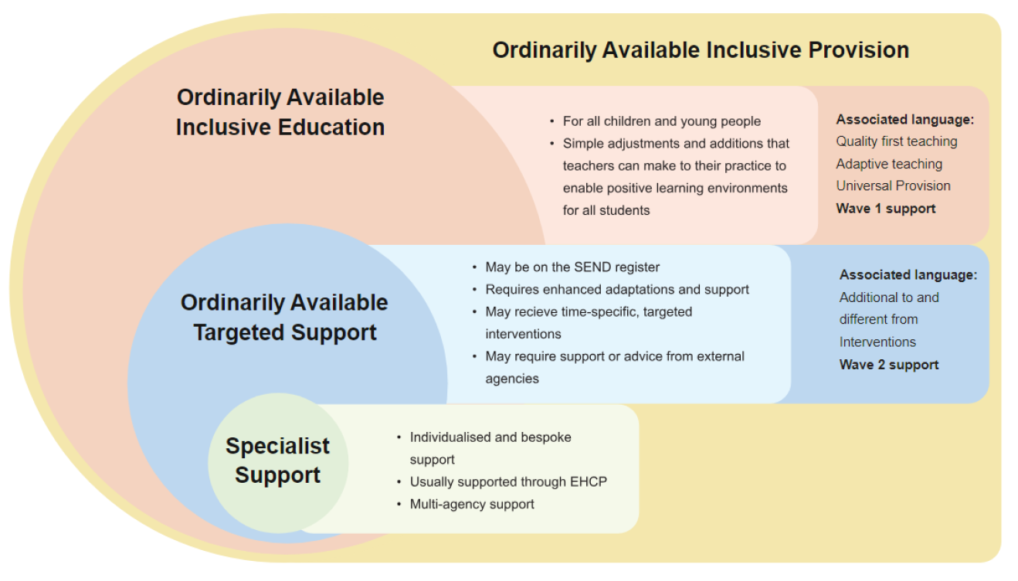
How will I know if my child has SEN?
Making ordinarily available inclusive provision available to all children means that fewer will require additional targeted support.
Where OAIP is not meeting the child’s educational needs and support is required that is ‘additional to and different from’ support which is available to other children of the same age, then a child or young person is identified as having special educational needs.
All children in mainstream schools will be able to have at least some of their needs met through ordinarily available inclusive provision, some children may need some provision that is part of the ordinarily available targeted support and a few children will need external or specialist assessment, advice or support.
In line with the SEND Code of Practice, we will always inform parents/carers if special educational provision is being put in place for your child and they are being placed on the school’s SEND register.

Slide 24


Definition of Special Educational Needs
(taken from SEND Code of Practice: 0 to 25 years – January 2015)
A pupil has SEN if they have a learning difficulty or disability which calls for special educational provision to be made for them. Namely provision that is different from or additional to that normally available to pupils of the same age. Making higher quality teaching normally available to the whole class is likely to mean that fewer pupils will require such support. (6.15 pg 94)

Slide 25
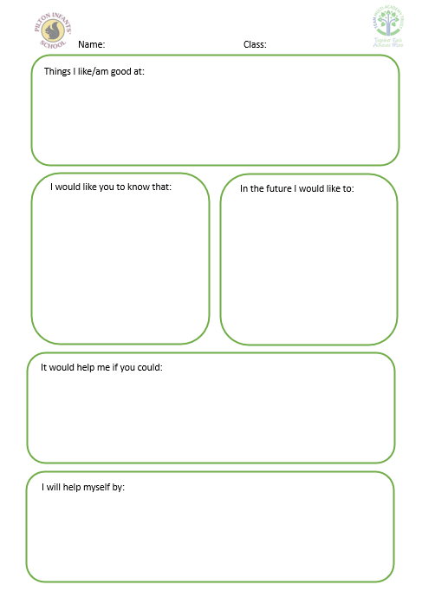
What if my child has a diagnosis, disability or identified need?
Under the Equality Act 2010, a disability is ‘a physical or mental impairment which has a long term and substantial adverse effect on their ability to carry out normal day-to-day activities’.
Finding out your child has a disability, specific diagnosis e.g. ADHD or Autism or an identified need e.g. hearing impairment, slow processing speed or poor working memory, can be a confusing and emotional time.
As well as dealing with your own concerns, you may also need to offer advice to other family members and coordinate contact and information from a number of different professionals. At some stage you will want to find out more about your child’s condition, need or disability itself.
To help capture all of this valuable and important information about your child, we will work with you to develop a ‘Pupil Passport’ that can then be shared with all adults who support them.
At Pilton Bluecoat all children at SEN Support, with an EHCP and those with a Highlighted Need will have a pupil passport.
Children will be identified as having a ‘Highlighted Need’ when they have a disability, specific diagnosis or identified need that can be met within the school’s OAIP.

Slide 26
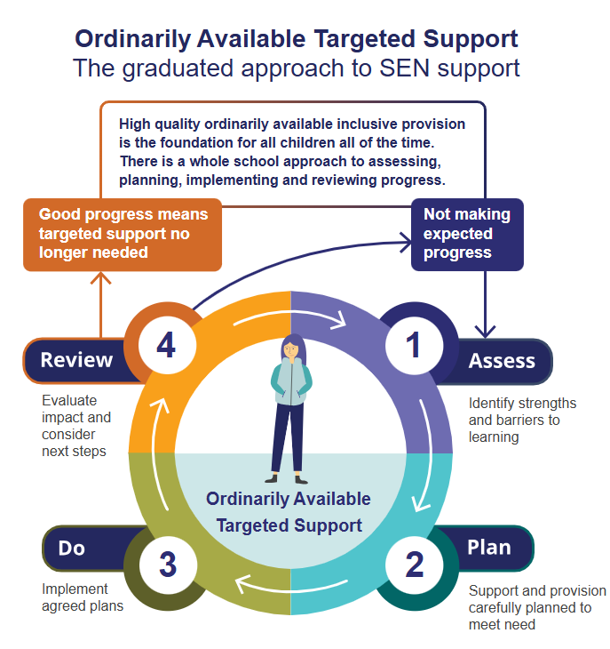
How are decisions made about what support my child needs?
Where a child is identified as having SEN then the school needs to put the appropriate support and provision in place to remove the barriers to learning.
This process involves a 4-step cycle of assess – plan – do – review. The cycle should be repeated regularly to evaluate the impact of support and interventions so that the child receives more of what is working.
Successive cycles should draw on more detailed assessments and may involve external support where this is required. This is known as the graduated approach.
The graduated approach is an ongoing form of assessment and support. It is not a single one-time process. This is because the support might not yet be right for the child and/or the needs of a child may change over time and the support will need to adjust to meet this change.
OAIP remains the foundation of inclusive practice and provision for those children who also require targeted support and/ or specific or specialist inputs.

Slide 27
What kinds of SEN are provided for at Pilton Bluecoat?
Cognition and Learning:
Accessing the curriculum
Executive functioning
Handwriting
Coordination
Reading fluency and comprehension
Number facts and calculating
Social, Emotional and Mental Health Needs:
Attention and Engagement
Relationships
Social understanding
Self-esteem and resilience
Emotional regulation
Wellbeing and mental health
Types of Special Educational Needs and Disabilities
Communication and Interaction:
Speech clarity
Attention and listening
Receptive language
Expressive language
Sensory processing and integration
Social communication
Attention and listening
Sensory and/or Physical:
Visual Impairment (VI)
Hearing Impairment (HI)
Multi-Sensory Impairment (MSI)
Physical Disability (PD)

Slide 28




What if my child’s needs are complex and I feel they can no longer be met by Pilton Bluecoats provision?
Where children have more complex needs, we would always do our best to make reasonable adjustments and devise an appropriate plan to meet their needs.
We recognise however, that as a mainstream setting, it may not always be possible to fully meet the needs of every child and that sometimes this may mean that a move to an alternative/specialist provision is in the best interests of your child.
We understand that this can be an upsetting and confusing time for families therefore we will:
  Support you in understanding the process of making a ‘Request for Statutory Assessment’ to consider if an Education, Health & Care Plan (EHCP) would be a suitable method of support (if your child doesn’t have one).
  Arrange an ‘Early Annual Review’ if your child does have an EHCP, so their placement (Section I) can be reviewed.
  Put you in touch with support services that may be able to help e.g. Devon Information Advice and Support (DiAS)
  Ensure we follow the advice laid out by specialist professionals.
  Consider whether support from our Trust Family Support Worker would be appropriate.
  Liaise closely with staff at your child’s new school should one be identified to ensure the transition is as smooth as possible.

Slide 29
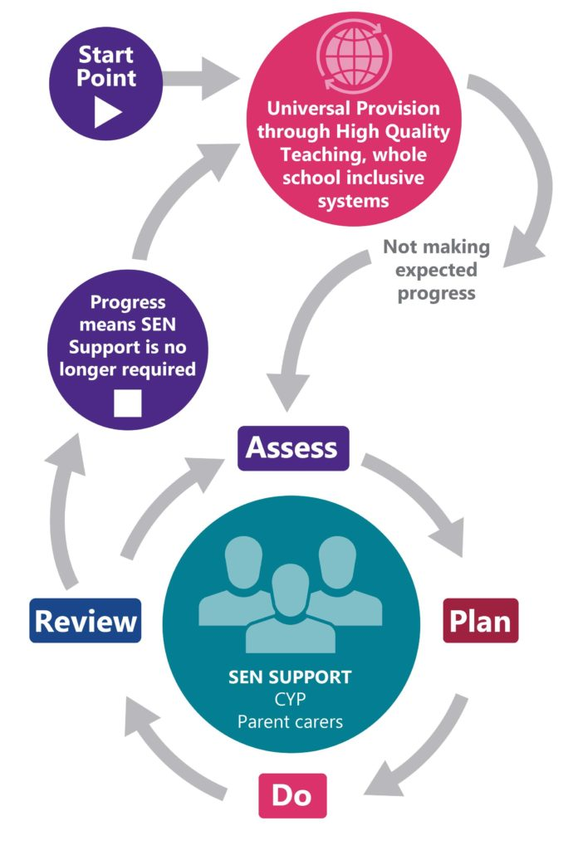
Who should I contact for more information or if I am concerned about my child?
Your child’s class teacher should always be your first point of contact.
The SEND Code of Practice is clear that teachers are both accountable and responsible for the progress and development of all children in their class, including those who access support from other members of staff and external professionals, and those with SEND.
Where necessary, the class teacher can then liaise with other members of staff e.g. the school SENDCo or escalate your concerns whilst retaining oversight of the provision in place for your child.
Where your child does not have SEN but there is a shared concern with their progress or development, this may mean that, in the short term, they are placed on the school’s ‘Monitoring List’ whilst this concern is explored further and appropriate provision to support them is identified.
This is the first step within the school’s graduated approach and the assess-plan-do-review cycle will then be implemented to evaluate the effectiveness of the support in place and decide the most appropriate next steps.
OAIP through whole school inclusive systems
Progress means support is no longer required
MONITORING

Slide 30
What should I do if I am not satisfied with a decision or what is happening?
Your first point of contact should be the person responsible – this may be your child’s class teacher, the school SENDCo or the Head of School.
You are encouraged to speak to them first and explain your concerns.
If you are not satisfied that your concern has been addressed, then please ask for the contact details of the most appropriate senior member of staff.
If you still feel the issues are unresolved, then please follow the Trust’s Complaints Procedure & Policy.
If your concern is with the Local Authority, then please contact Devon Information Advice and Support (DiAS) or Parent Carer Forum Devon.
Pilton Bluecoat C of E Academy - TEAM TRUST POLICIES
Devon Information Advice and Support
Parent Carer Forum Devon

