Slide 1

SPEAK LIKE AN EXPERT

Slide 2
trenches | Allies | Central Powers | conflict | The Great War
Archduke Franz Ferdinand | armistice | remembrance | weapons | artillery
assassination | causes | truce | peace | soldier
Notes:
Read through the words as a class.
I say – you say – I say – you point.

Slide 3
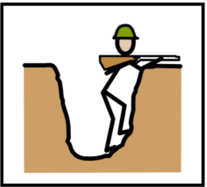
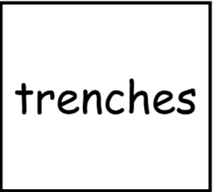
Notes:
Matching Task - Which word matches this picture? GT - Is there more than one answer? Why is it this one? Why is it not this one?

Slide 4
Memory Pairs
Turn all of your 15 cards over!
Notes:
Memory pairs game - in groups children to turn all cards over and ‘shuffle’. Can they match the cards to the words.
LA - to work with adult.

Slide 5
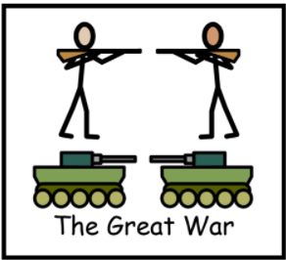
Sentence Battle
The Great War started in 1914.
This is the Great War.
World War 1, which is also known as the
Great War, started in 1914.
Notes:
Which sentence would an expert use? Why?
Why is this a good example? Why is this not a good example?
Can you think of an even better sentence?

Slide 6
LET’S PLAY
SENTENCE BATTLE!!!
Notes:
All members of the groups to state their sentences together.
Award points for good sentences. Award 2 points for Expert Sentences.

Slide 7
Task ideas:
Shorting cards (which have you heard before, which words could you explain to someone else.
Give definition – which would is it?
Give sentence with missing word. Which word completes sentence?
Picture match / put into sentence (orally)
Headbands / Guess Who?
Longest linked sentence (start with 2 cards).
Taboo Game
Notes:
What do these words have in common? All about WW1.

