Slide 1
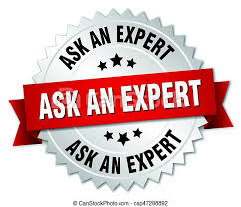
SPEAK LIKE AN EXPERT

Slide 2
trenches | Allies | Central Powers | conflict | The Great War
Archduke Franz Ferdinand | armistice | remembrance | weapons | artillery
assassination | causes | truce | peace | soldier
Notes:
Show for 1 minute, then move on to next slide.

Slide 3
In your groups, on a whiteboard.
How many of the 15 Speak Like an Expert words can you remember in 3 minutes?
GO!

Slide 4
trenches | Allies | Central Powers | conflict | The Great War
Archduke Franz Ferdinand | armistice | remembrance | weapons | artillery
assassination | causes | truce | peace | soldier
Notes:
Read through the words as a class.
I say – you say – I say – you point.

Slide 5

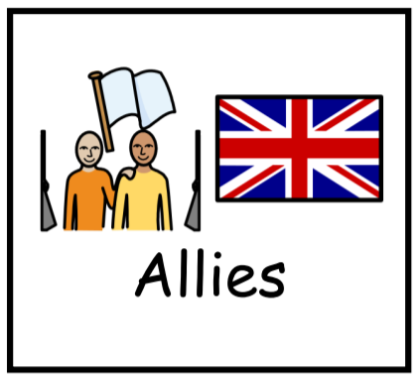
SENTENCE WARM UP
Notes:
Children have widget cards with word + pic on in a pile face down. Take in turns to pick up a card. Child composes a sentence about the word card chosen. If the sentence is factually accurate and makes sense, they keep the card. The winner is the player with the most cards.

Slide 6
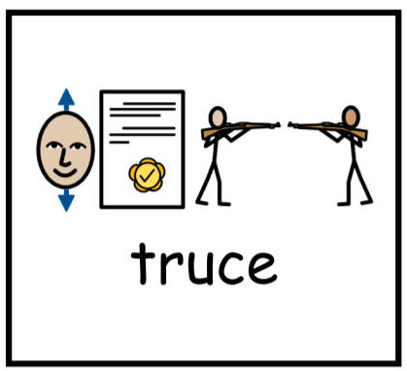
If this was your picture, what could your sentence be?
Notes:
All members of the groups to state their sentences together.
Award points for good sentences. Award 2 points for Expert Sentences.

Slide 7
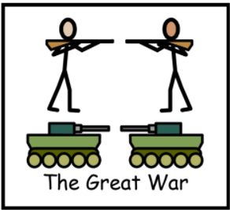
Sentence Battle
The Great War started in 1914.
This is the Great War.
World War 1, which is also known as the
Great War, started in 1914.
Notes:
Which sentence would an expert use? Why?
Why is this a good example? Why is this not a good example?
Can you think of an even better sentence?

Slide 8
LET’S PLAY
SENTENCE BATTLE!!!
Notes:
All members of the groups to state their sentences together.
Award points for good sentences. Award 2 points for Expert Sentences.

Slide 9
Task ideas:
Shorting cards (which have you heard before, which words could you explain to someone else.
Give definition – which word is it?
Give sentence with missing word. Which word completes sentence?
Picture match / put into sentence (orally)
Headbands / Guess Who?
Longest linked sentence (start with 2 cards).
Taboo Game
Notes:
What do these words have in common? All about WW1.

