Slide 1
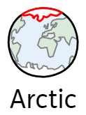
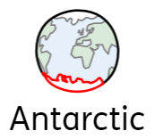
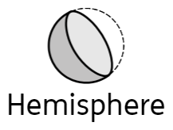
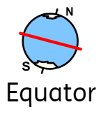
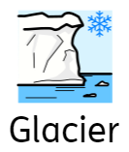
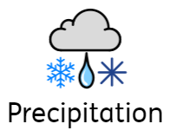
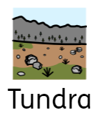
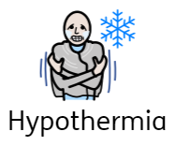

 |  | Shackleton | ‘Endurance’
 |  |  | Permafrost
Plateau |  | Weddell Sea | Indigenous

Slide 2
A polar region located at the northernmost part of Earth. It consists of the Arctic Ocean, adjacent seas, and parts of Alaska (United States), Canada, Finland, Greenland (Denmark), Iceland, Norway, Russia, and Sweden. | Earth's southernmost continent. Situated almost entirely south of the Antarctic Circle and surrounded by the Southern Ocean. | British explorer who led an expedition to attempt to walk across Antarctica. However, his ship became stuck in sea ice and sank. He and his men managed to survive for 18 months before making their way to safety. | The three-masted vessel in which Sir Ernest Shackleton and a crew of 27 men and one cat sailed for the Antarctic on the 1914–1917. She was launched in 1912 from Sandefjord in Norway; three years later, she was crushed by pack ice and sank in the Weddell Sea off Antarctica. All of her crew survived. | Any ground that remains completely frozen—32°F (0°C) or colder—for at least two years straight. These permanently frozen grounds are most common in regions with high mountains and in Earth's higher latitudes—near the North and South Poles.
Massive bodies of slowly moving ice. They form on land, and they are made up of fallen snow that gets compressed into ice over many centuries. They move slowly downward from the pull of gravity. | All liquid and solid water particles that fall from clouds and reach the ground. These particles include drizzle, rain, snow, snow pellets, ice crystals, and hail. | An imaginary line around the middle of a planet or other celestial body. It is halfway between the North Pole and the South Pole, at 0 degrees latitude. It divides the planet into a Northern Hemisphere and a Southern Hemisphere. | The name given to half a sphere, cut in half through its widest point. It is most commonly used when describing different areas of the earth. | A group of culturally similar indigenous peoples inhabiting the Arctic and subarctic regions of Greenland, Canada, and Alaska.

Slide 3
A raised area of land that's flat on top, sometimes found in mountainous area. | When the body gets so cold that it can't warm itself up again. This can be dangerous because the organs inside the body will stop working if they get too cold. | An area of land where it is too cold for trees to grow and the ground below the surface is permanently frozen. | The body of water that sits to the east of the arm that is the Antarctic Peninsula and the main body of the continent. A unique expanse of water with huge icebergs, menacing ice floes and giant ice shelves. | Occurring naturally or originating in a particular place.

